Slide 1
Insect Biodiversity and Conservation Biology
evaluation CAS 2015 – 2019

Slide 2
Insect Biodiversity and Conservation Biology
Mission
- exploring and conserving biodiversity
cross-section among ecology, taxonomy, conservation and society
Structure
Laboratories (4+1):
Aquatic Insect Biodiversity and Ecology
Entomopathogenic Nematodes
Temperate biodiversity
Woodland ecology
Aphidology (activity ceased in 2019)

Slide 3
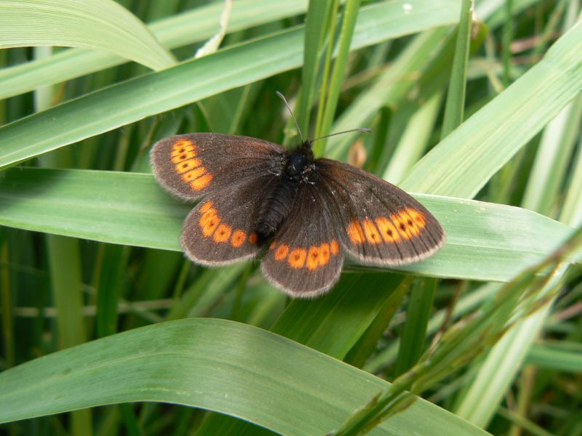
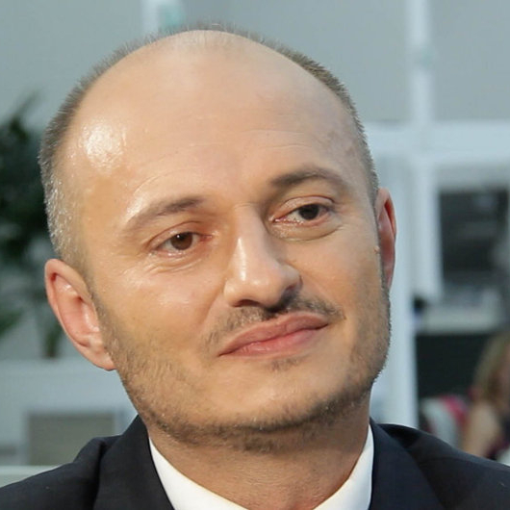
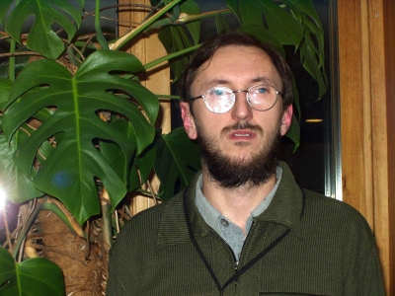
Insect Biodiversity and Conservation Biology
Laboratory of Temperate biodiversity
Head: Martin Konvička Researchers:
Jana Lipárová
Alena Sucháčková
Zdeněk Faltýnek Fric
Lukáš Spitzer
Pavel Vrba
PhD Students: 6
Undergraduates: 3

Slide 4
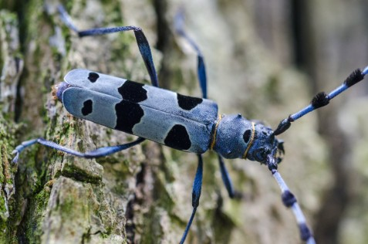
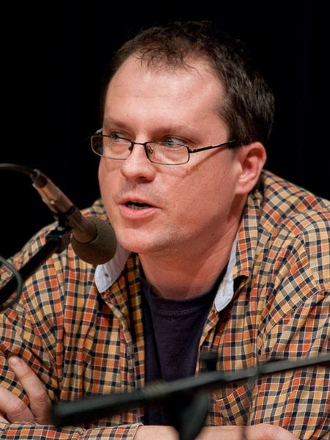
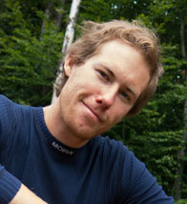
Insect Biodiversity and Conservation Biology
Laboratory of Woodland Ecology
Head: Lukáš Čížek Researchers:
Pavel Šebek
Lukáš Drag
František Sládeček
PhD Students: 6
Undergraduates: 2

Slide 5
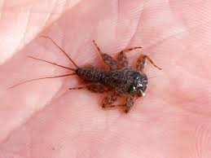
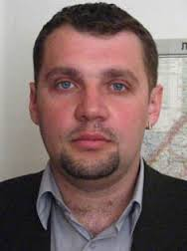
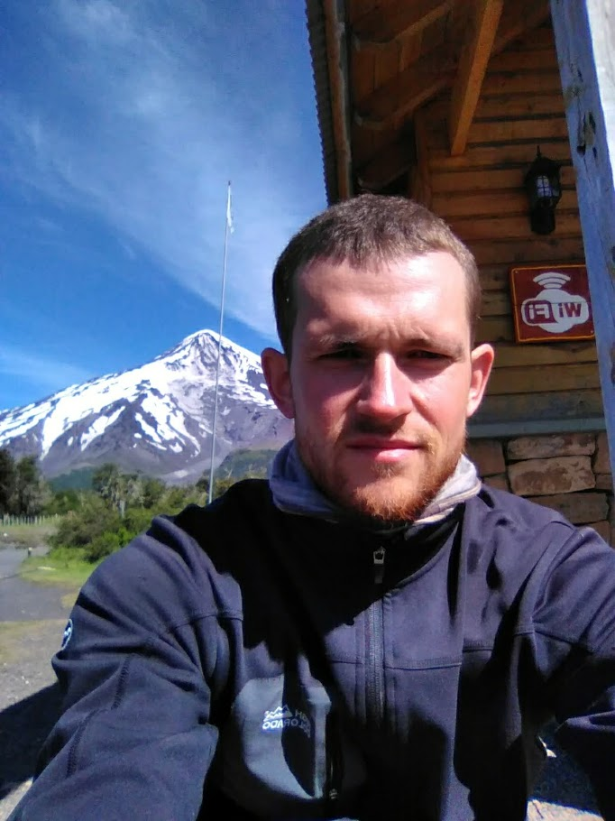
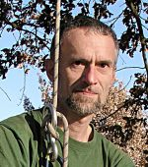
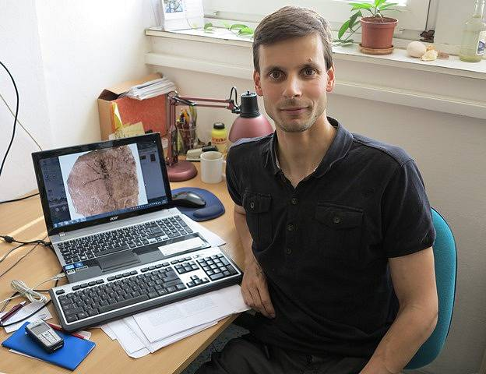
Insect Biodiversity and Conservation Biology
Laboratory of Aquatic Insect Biodiversity and Ecology
Head: David S. Boukal Researchers:
Roman J Hodunko
Luboš Hrivniak
Vlastimil Růžička
Pavel Sroka
PhD Students: 4

Slide 6
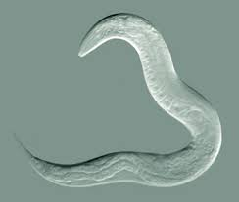
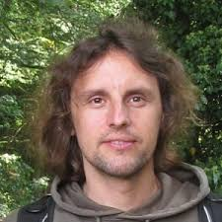
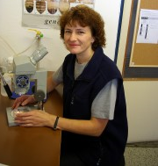
Insect Biodiversity and Conservation Biology
Laboratory of Entomopathogenic Nematodes
Head: Vladimír Půža Researchers:
Martina Žurovcová
Jiří Nermuť
Undergraduates: 10

Slide 7
Insect Biodiversity and Conservation Biology
Main topics vs. labs
Slide 3 – Main topics vs. labs Global change -
Biodiversity and conservation -
Biogeography in conservation - Interactions -
Outreach -
 | Temperate biodiversity | Woodland Ecology | Aquatic Insects | Entomopatogenic Nematodes
Global change | + | - | + | +
Biodiversity and conservation - | + | + | + | +
Biogeography in conservation - | + | + | - | -
Interactions - | + | + | + | +
Outreach - | + | + | + | +

Slide 8
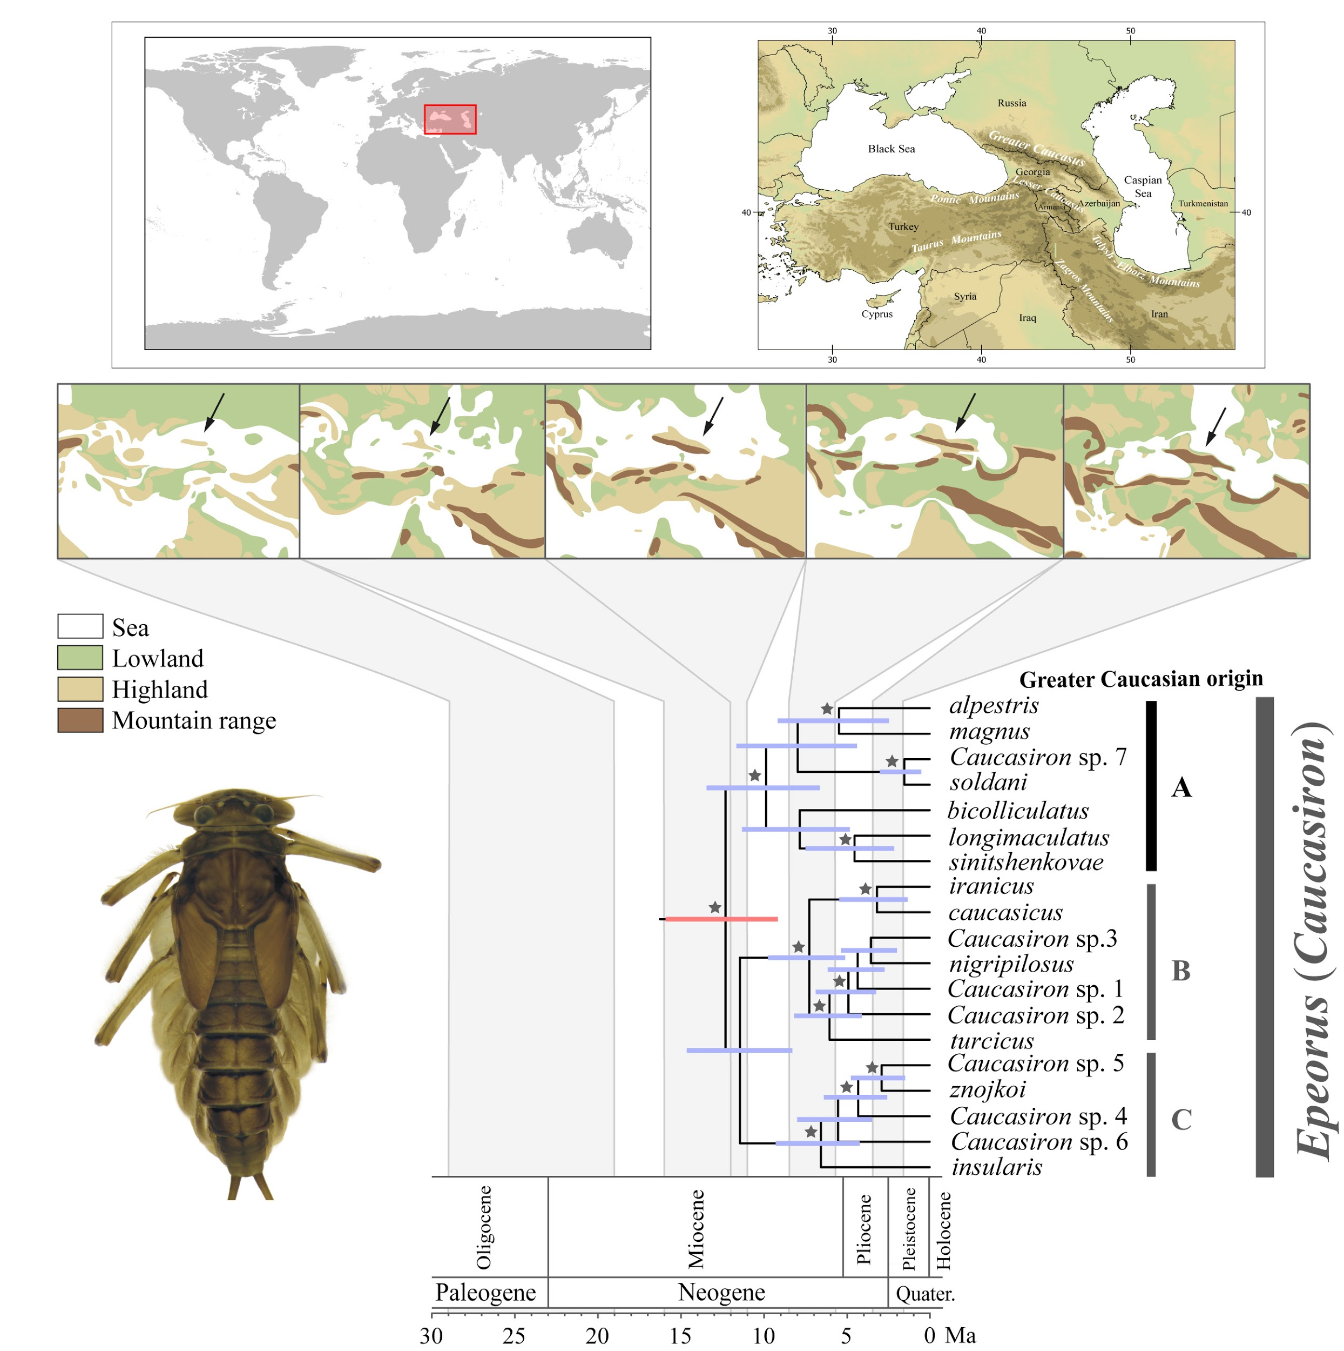
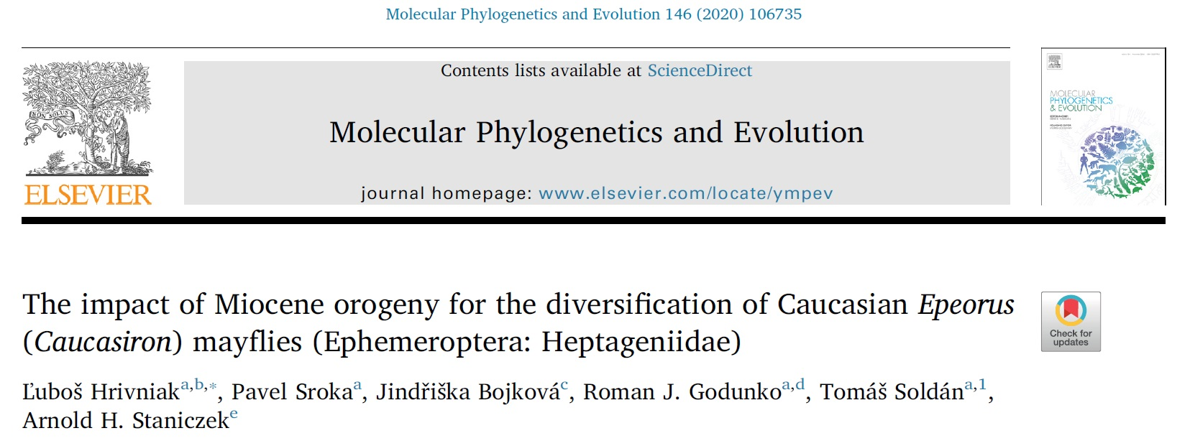
Insect Biodiversity and Conservation Biology
Laboratory of Aquatic Insects
We clarified how the orogeny of the Caucasus mountains affected the evolution of mayflies in this area.
The time-calibrated phylogeny was constructed based on five DNA markers.
2020

Slide 9
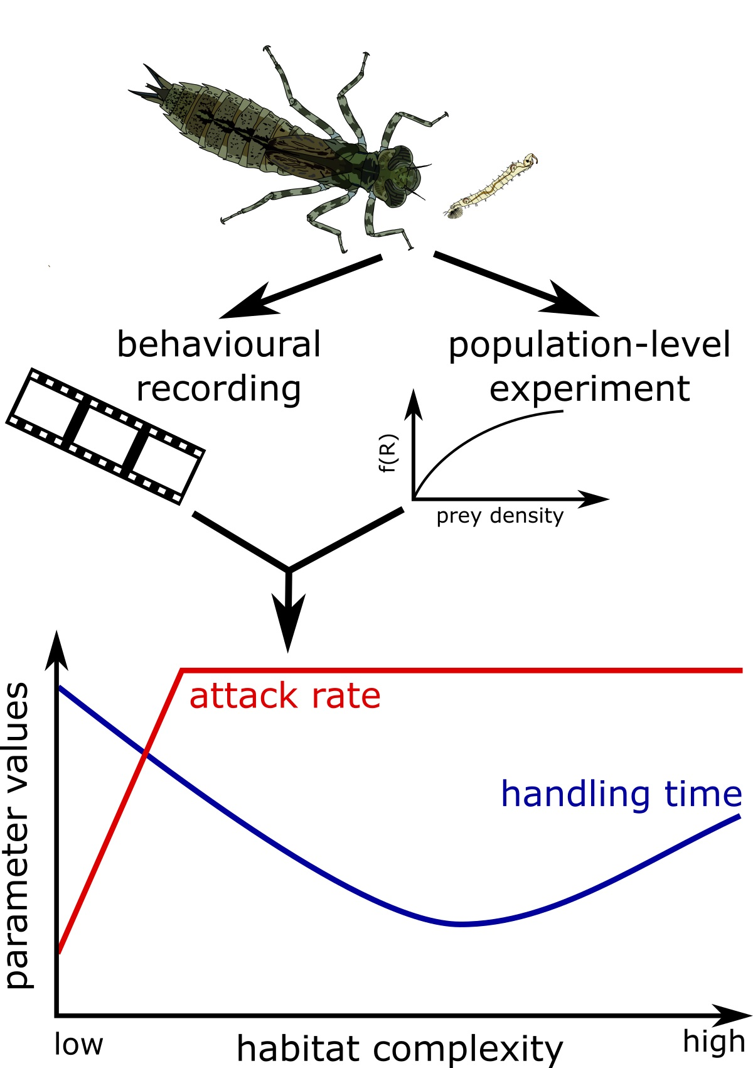
Insect Biodiversity & Conservation Biology / Laboratory of Aquatic Insects
Mocq J, Soukup P, Näslund J, Boukal DS (Journal of Animal Ecology, in press):
Disentangling the nonlinear effects of habitat complexity on functional responses
we show that effects of environmental conditions on trophic interactions are often nonlinear
(lab experiment)
Notes:
Habitat complexity can affect community structure and dynamics through its effects on trophic interactions, which are expressed as consumer functional responses.
We quantified functional responses along a habitat complexity gradient from entirely unstructured to highly structured habitat in a freshwater system, using dragonfly larvae (Aeshna cyanea) preying on Chaoborus obscuripes larvae.
We combined two different approaches – a population-level and a behavioural experiment– to show that the two key parameters of functional response (attack rate and handling time) change non-linearly along the habitat complexity gradient, and compared our results to previous studies.

Slide 10
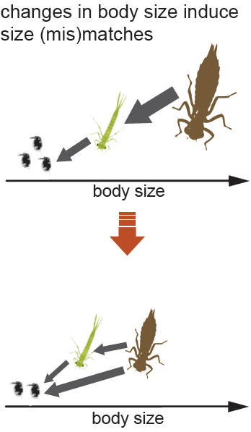
Insect Biodiversity & Conservation Biology / Laboratory of Aquatic Insects
Sentis A, Binzer A, Boukal DS (2017) Ecology Letters:
Temperature-size responses alter food chain persistence across environmental gradients
we show that phenotypic plasticity plays important role in the effects of warming climate on communities (food web model)
Figure from Boukal et al. (2019) Current Opinion in Insect Science
Notes:
Body-size reduction is a ubiquitous response to global warming alongside changes in species phenology and distributions.
Using a food-chain model informed by empirical data, we found that temperature-size responses often increase community persistence by modifying consumer-resource size ratios and thereby altering interaction strengths and energetic efficiencies.
We predicted that the consequences of temperature-size responses are stronger in aquatic than in terrestrial ecosystems.
Considering the links between phenotypic plasticity, environmental drivers and species interactions is crucial to better predict global change impacts on ecosystem diversity and stability.

Slide 11
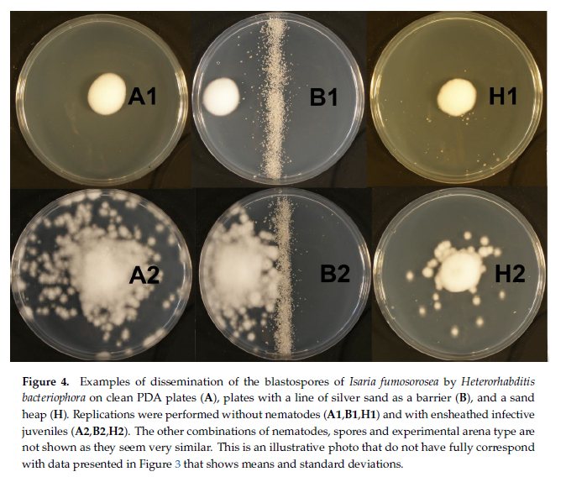
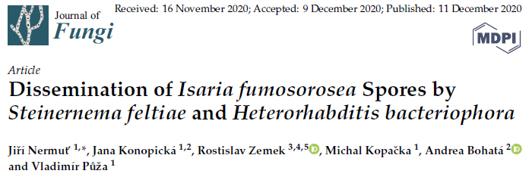
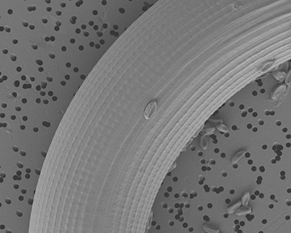
Insect Biodiversity and Conservation Biology
Laboratory of Entomopathogenic Nematodes
Entomopathogenic nematodes enhance dispersal of entomopathogenic fungus
We show, for the first time, that entomopathogenic nematodes are able to disseminate entomopathogenic fungus in the environment. We demonstrate that the level of fungal dissemination depends on the nematode species, spore type and heterogeneity of the environment.
-
.
.
.

Slide 12
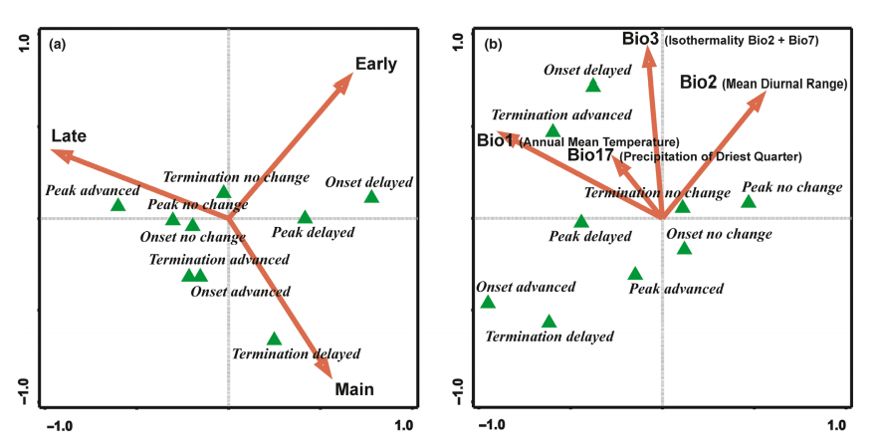
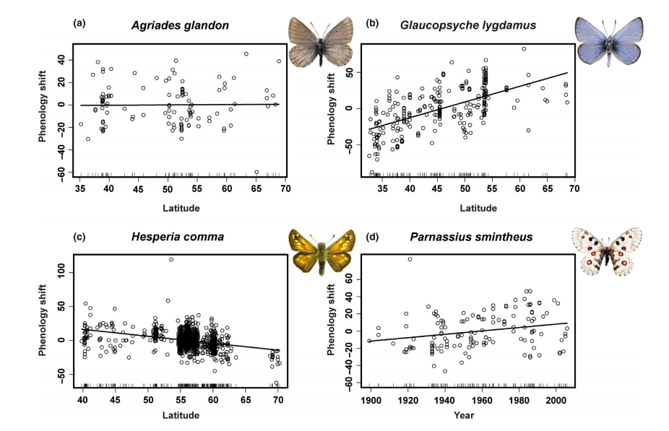
Insect Biodiversity and Conservation Biology
Laboratory of Temperate Biodiversity
Fric Z, Rindoš M, Fric Z
Using large data from Europe and North America, we found that not all butterfly species advance their flight periods in southern latitudes and delay in northern ones. For part of species, the pattern is different.
If the climate warms up, northern butterffles will form spring, summer and autumn phenology aspects, similar to butterflies in lower atitudes.
.
..
Notes:
Doprava bych nějakým puntíkem dal, že to je “climate change” agenda

Slide 13
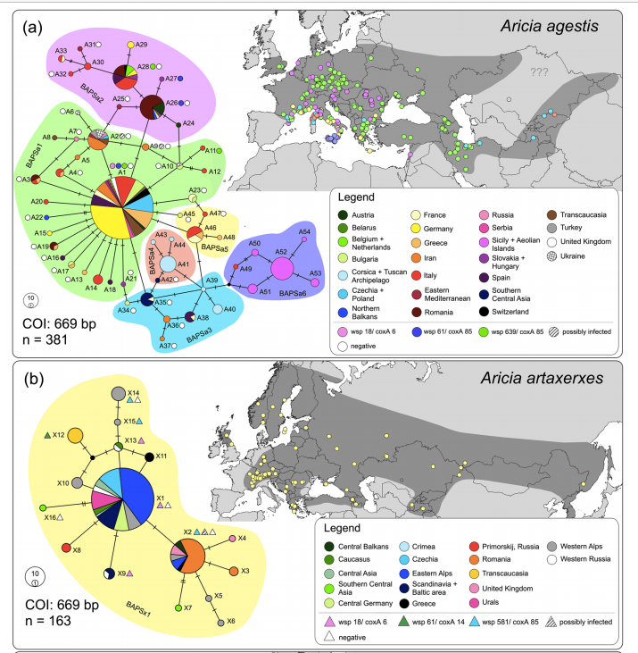
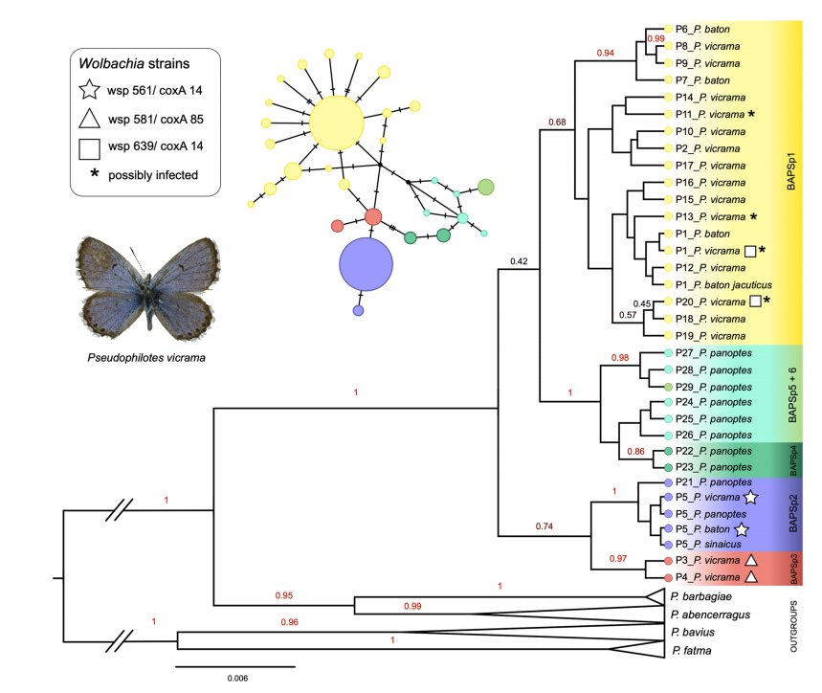
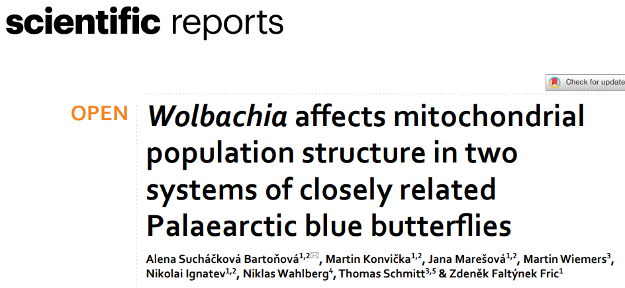
Insect Biodiversity and Conservation Biology
Laboratory of Temperate Biodiversity
Endoparasitic bacteria may distort mitochondrial signal of butterfly phylogeny
Wolbachia is a common mithochodrial parasite in insects, includieng blues butterflies. It can evolutionary inference based on mitochondrial DNA sequencing, but on the other hand, if individual strains of the bacteria are sequenced from infected butterflies,it may provide deeper knowledge of complicated taxa evolutionary history.
-
.
.
.

Slide 14
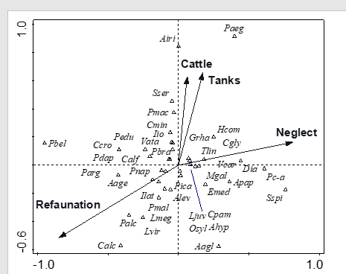
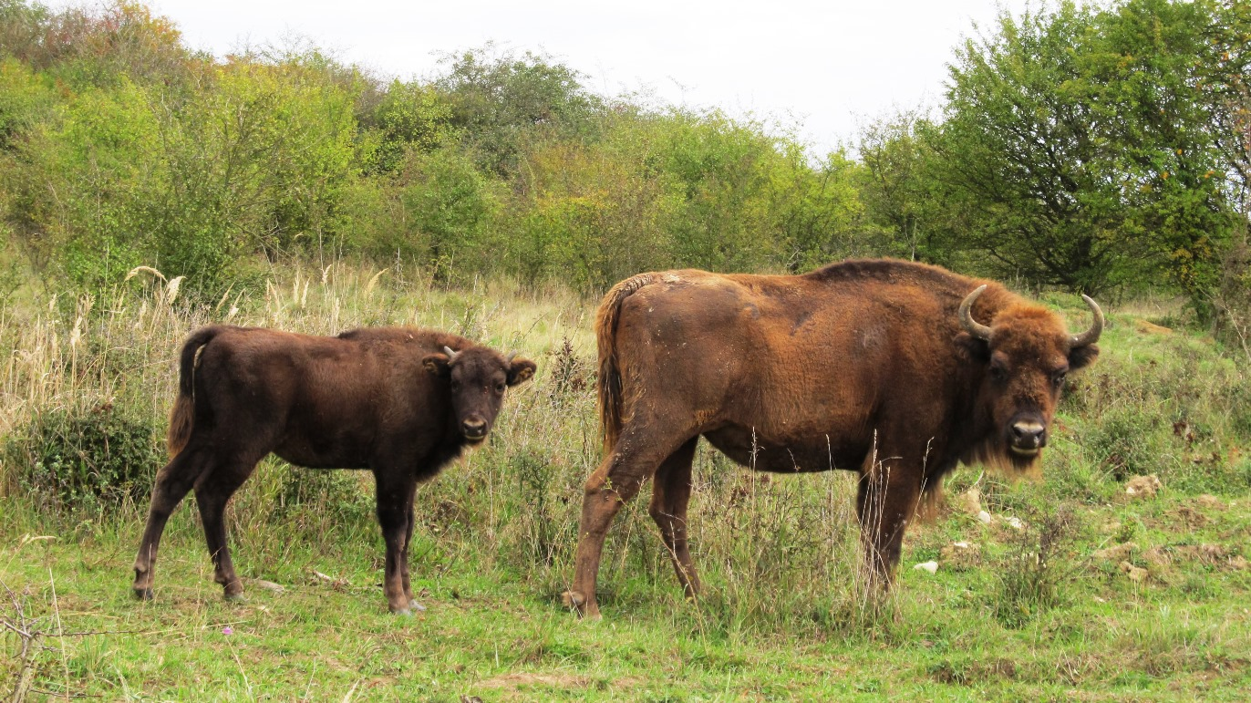
Insect Biodiversity and Conservation Biology
Laboratory of Temperate Biodiversity
Monitorng impacts of wild ugulatess refaunation
European ecosystems / biodiversity had evolved under strong influence of large megafauna grazers. Bringing them back may provide the optimistic agenda for coservation in XXI. century. Our publication under review documents positive effects on specialised grassland butterflies.
-
.
.
.

Slide 15
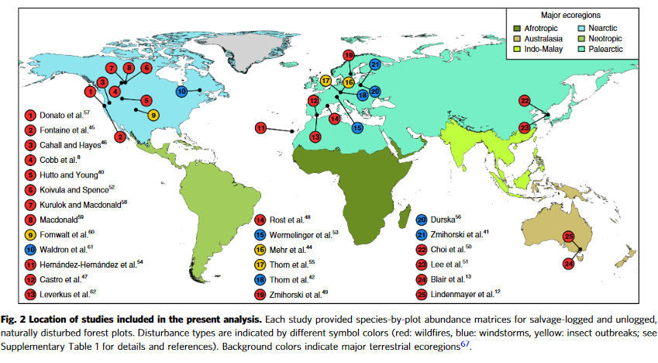
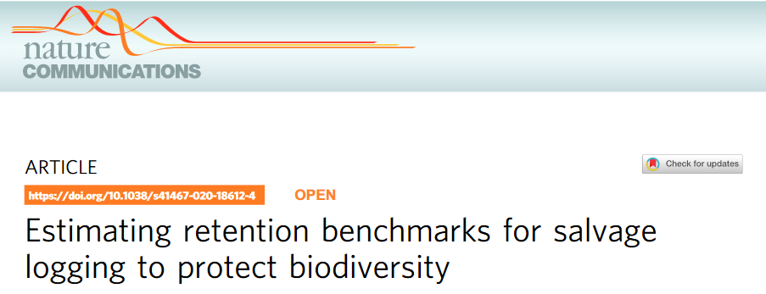
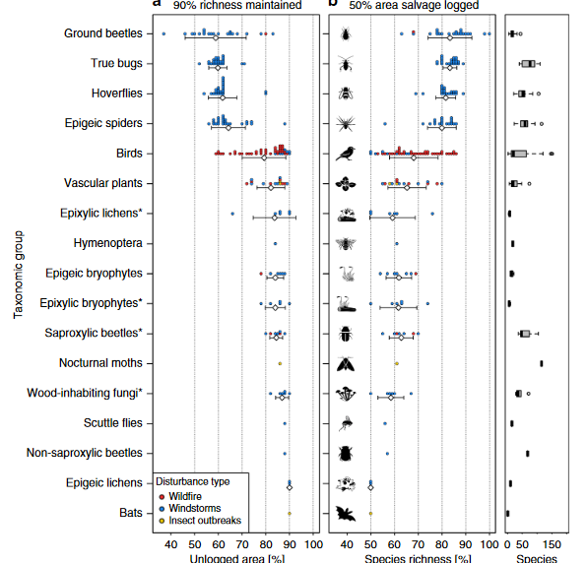
Insect Biodiversity and Conservation Biology
Laboratory of Woodland Ecology
-
.
.
.
NATURE COMMUNICATIONS| (2020) 11:4

Slide 16
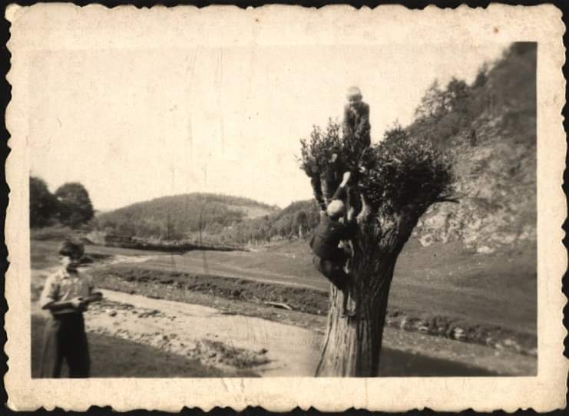
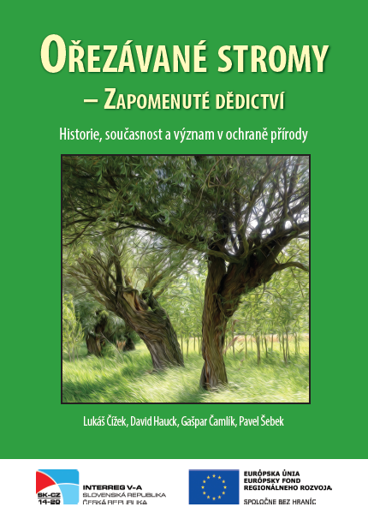
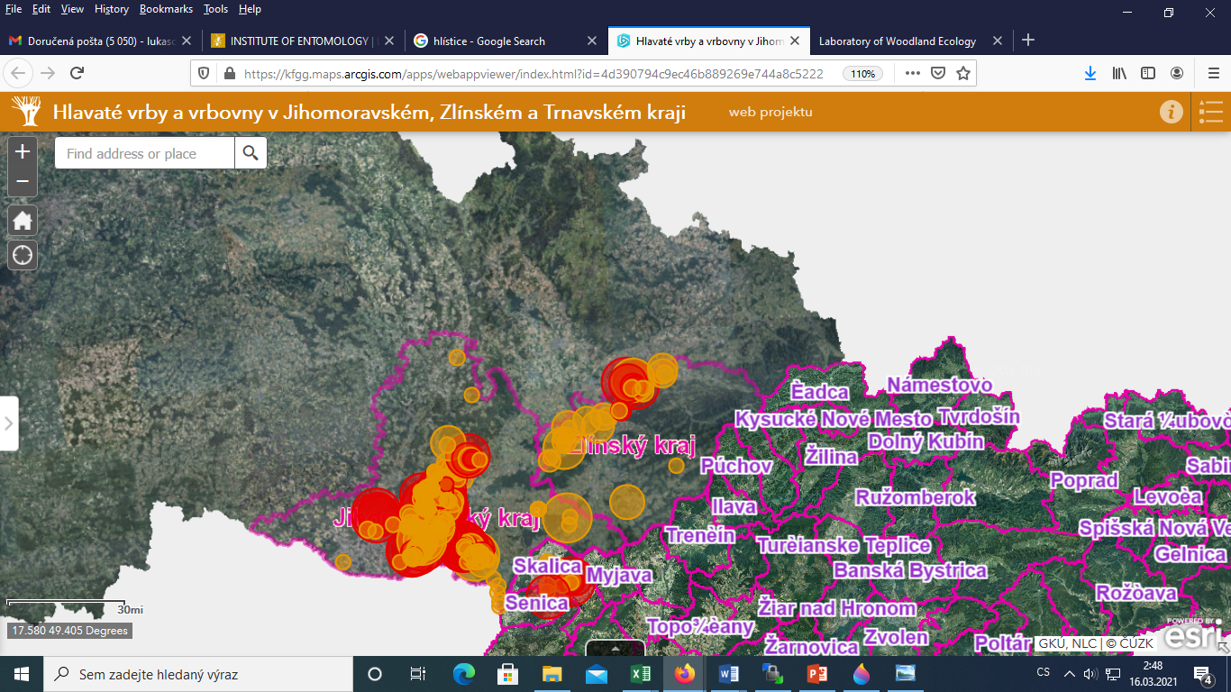
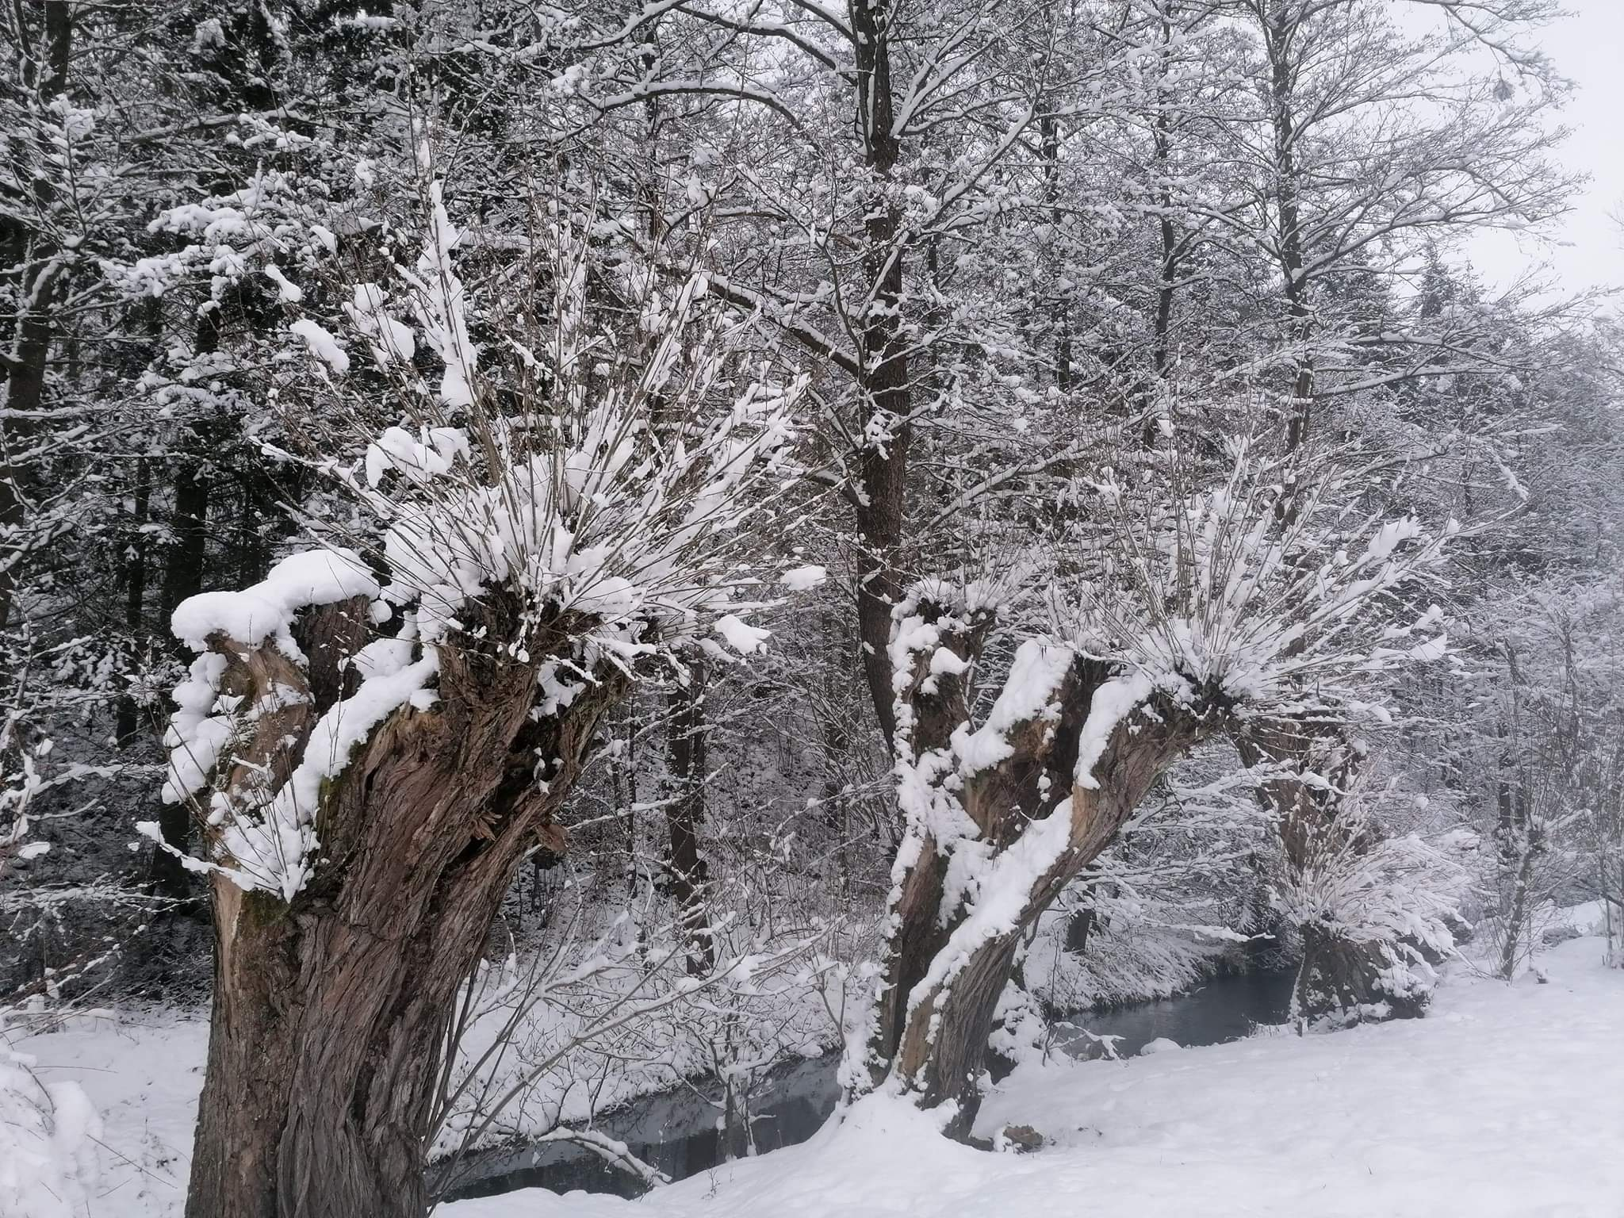
Insect Biodiversity and Conservation Biology
Laboratory of Woodland Ecology
-
.
.
.
Pollards
Journal of Insect Conserv. Čížek et al., in press
On-line map & database
Book on how and why to pollard
Restoration ⬅ Information accumulation and sharing ⬅ Research (ento/landscape/dendro)

Slide 17
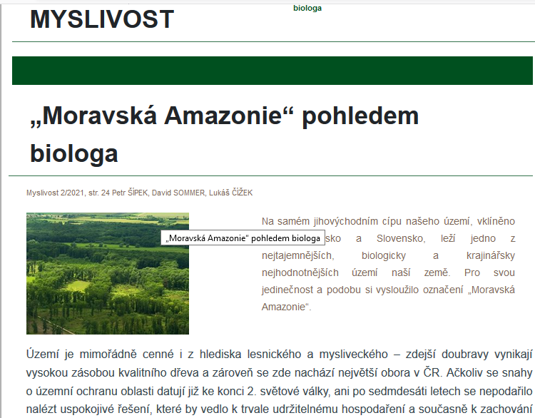
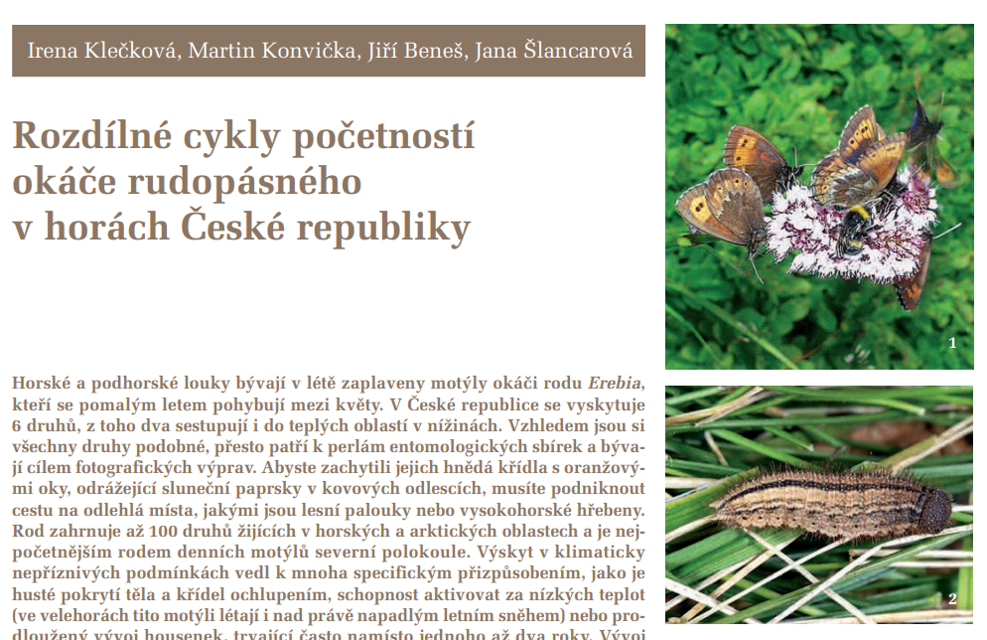
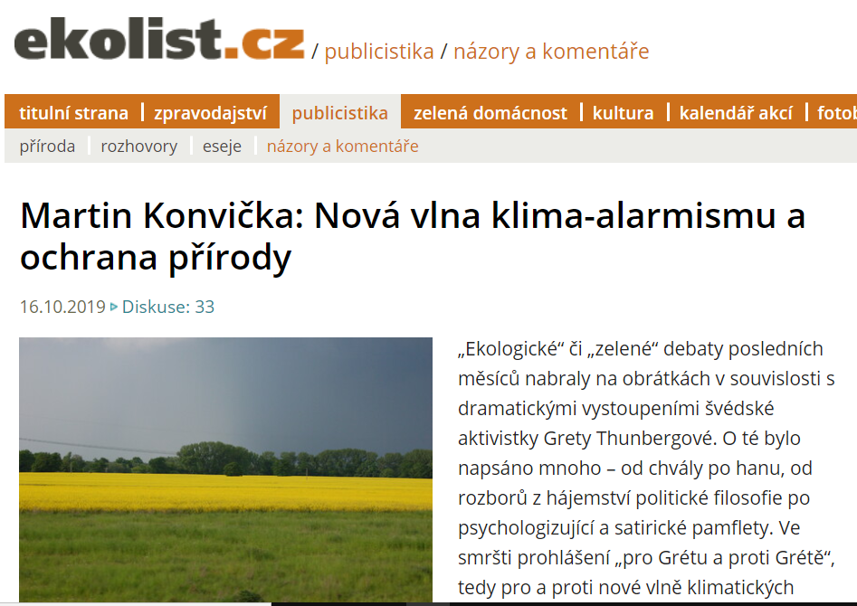
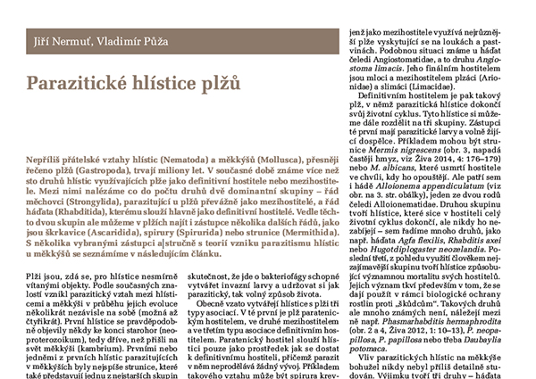
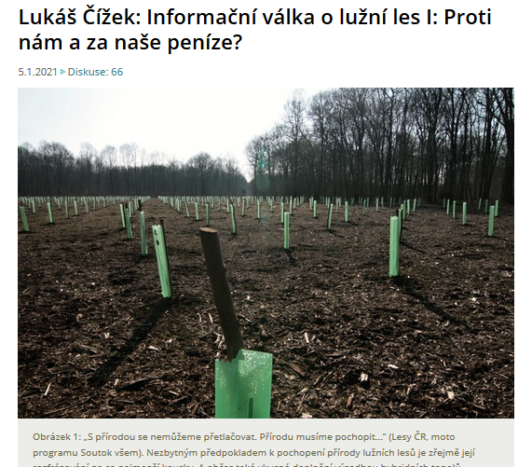
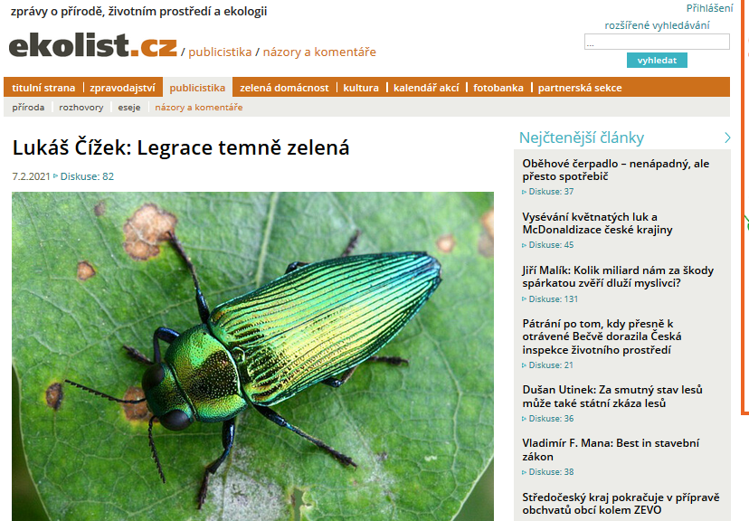
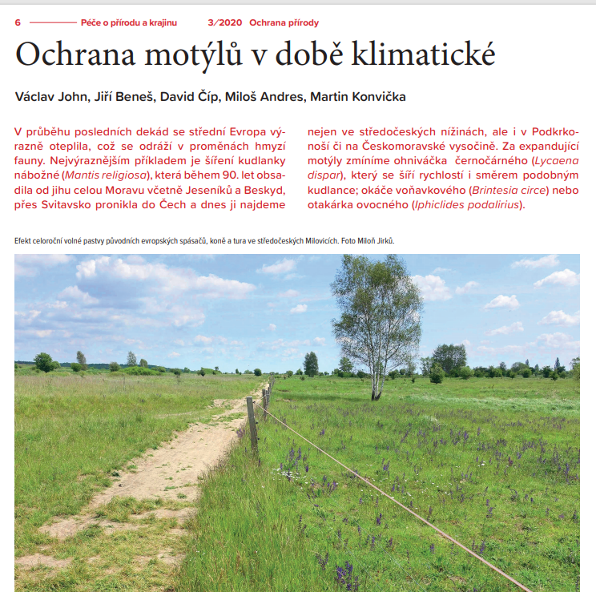
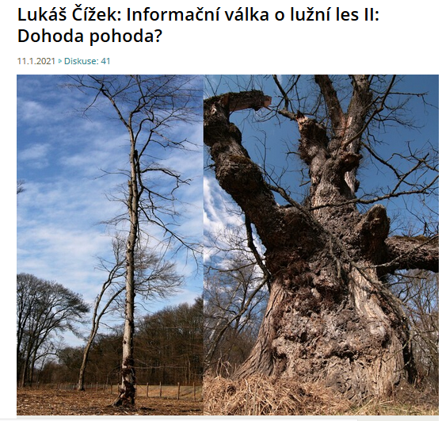
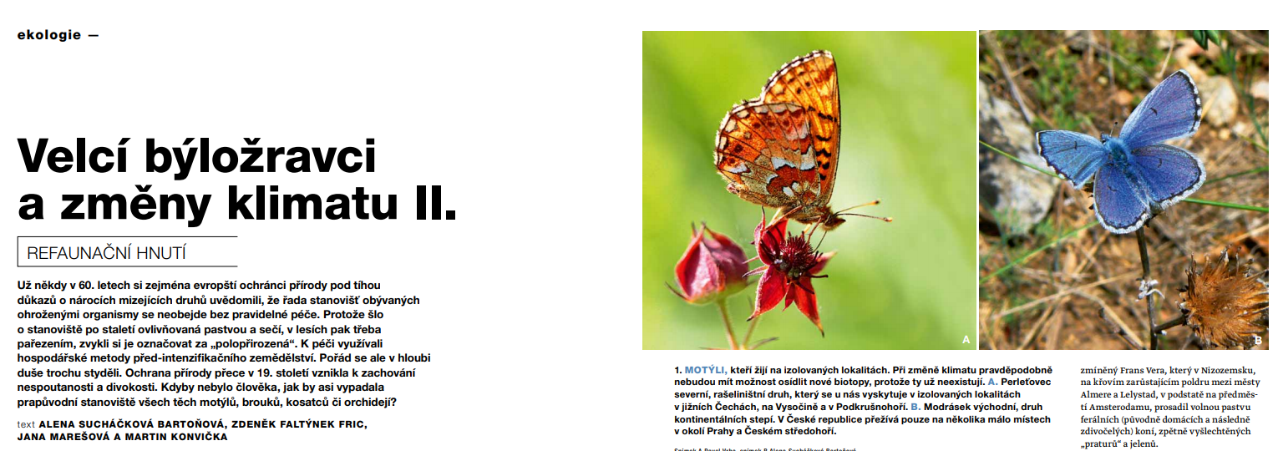
Insect Biodiversity and Conservation Biology
Outreach - popular articles – mainly 2021
Notes:
LUKASI - mozna z toho outreache udelat 1 samost. slide jen s takovymi obrazky, vcetne “Ciza v televizi”, at to vypada jak jsme velkolepi? (coz jsme?)

Slide 18
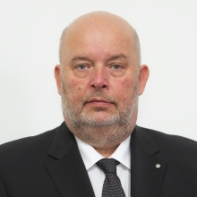
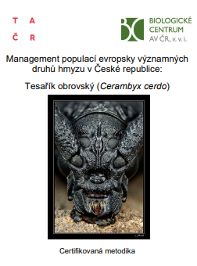
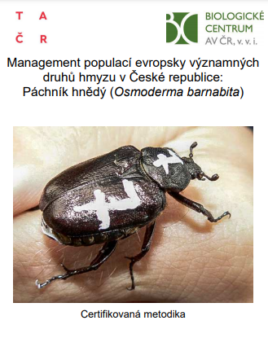
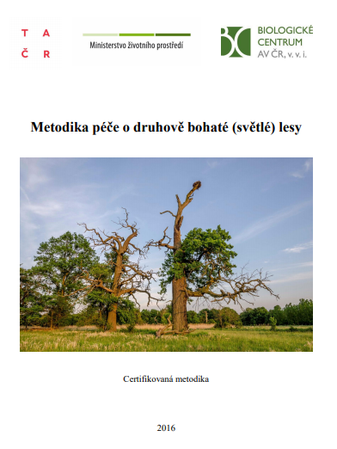
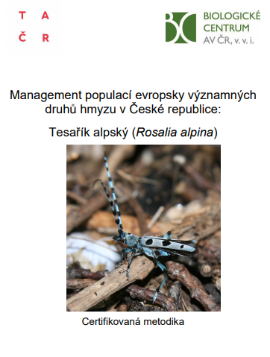
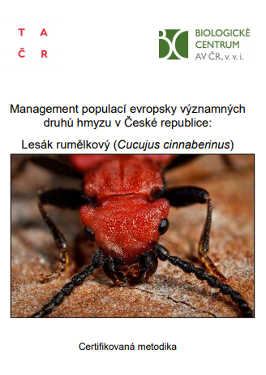
AgroMinister
Czech PM
Insect Biodiversity and Conservation Biology
Outreach –collaboration with NatCons (gov/NGOs/priv.)
guidebooks (species and habitat management)
maps, land use change analyses Teaching ( talks, presentations, media releases meetings with …
Notes:
LUKASI - mozna z toho outreache udelat 1 samost. slide jen s takovymi obrazky, vcetne “Ciza v televizi”, at to vypada jak jsme velkolepi? (coz jsme?)

Slide 19
Insect Biodiversity and Conservation Biology
Teaching – mainly (not only) University of South Bohemia
Courses:
Animal Ecology
Evolutionary Ecology
Introduction to Modelling in R for Ecologists,
Diversity of life
Introductory zoology (partim)
Conservation biology (partim)
Animal conservation
European fauna and its conservation
Insect diversity and conservation
Systematic entomology (partim)
Mark-recapture methods
Woodland Ecology (partim)
Animal Plant Interactions (partim)
Field course of alpine zoology
Field course of Entomology
Notes:
LUKASI - mozna z toho outreache udelat 1 samost. slide jen s takovymi obrazky, vcetne “Ciza v televizi”, at to vypada jak jsme velkolepi? (coz jsme?)

Slide 20
Insect Biodiversity and Conservation Biology
Funding (jake projekty a finance)
CZECH SCIENCE FOUNDATION – 8 projects
CZECH TECHNOLOGY FOUNDATION – 7 projects
NATIONAL AGENCY FOR AGRICULTURAL RESEARCH – 1
INTERREG – 1
NORWAY FUNDS – 1
CZECH MINISTRY OF ENVIRONMENT
CZECH MINISTRY OF EDUCATION, YOUTH, AND SPORTS
NATURE CONSERVATION AGENCY OF THE CZECH REPUBLIC
ADMINISTRATIONS OF NATIONAL PARKS
CITY OF PRAGUE….
Notes:
LUKASI - mozna z toho outreache udelat 1 samost. slide jen s takovymi obrazky, vcetne “Ciza v televizi”, at to vypada jak jsme velkolepi? (coz jsme?)

Slide 21
Insect Biodiversity and Conservation Biology
Outlook
Team Structure
Age structure
Internationalisation
Funding

Slide 22
Thank you for your attention

