Slide 1
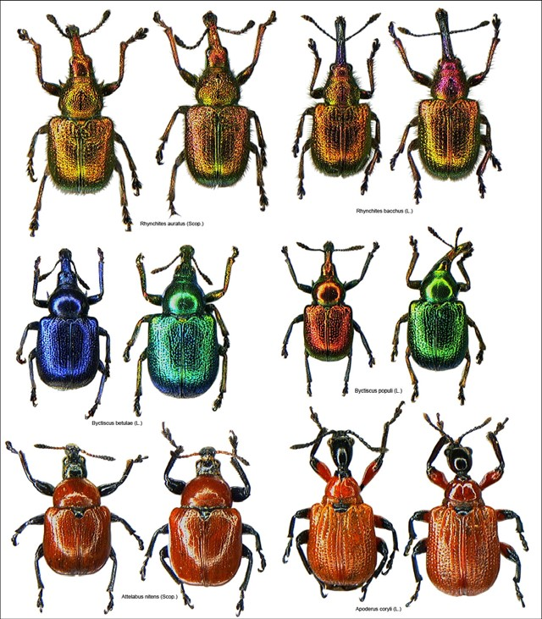
Plant – animal interactions (_{KBE 049)}
Herbivory

Slide 2
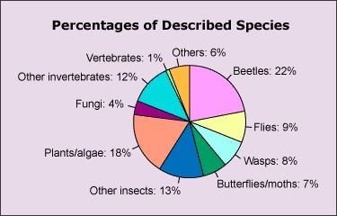

Slide 4
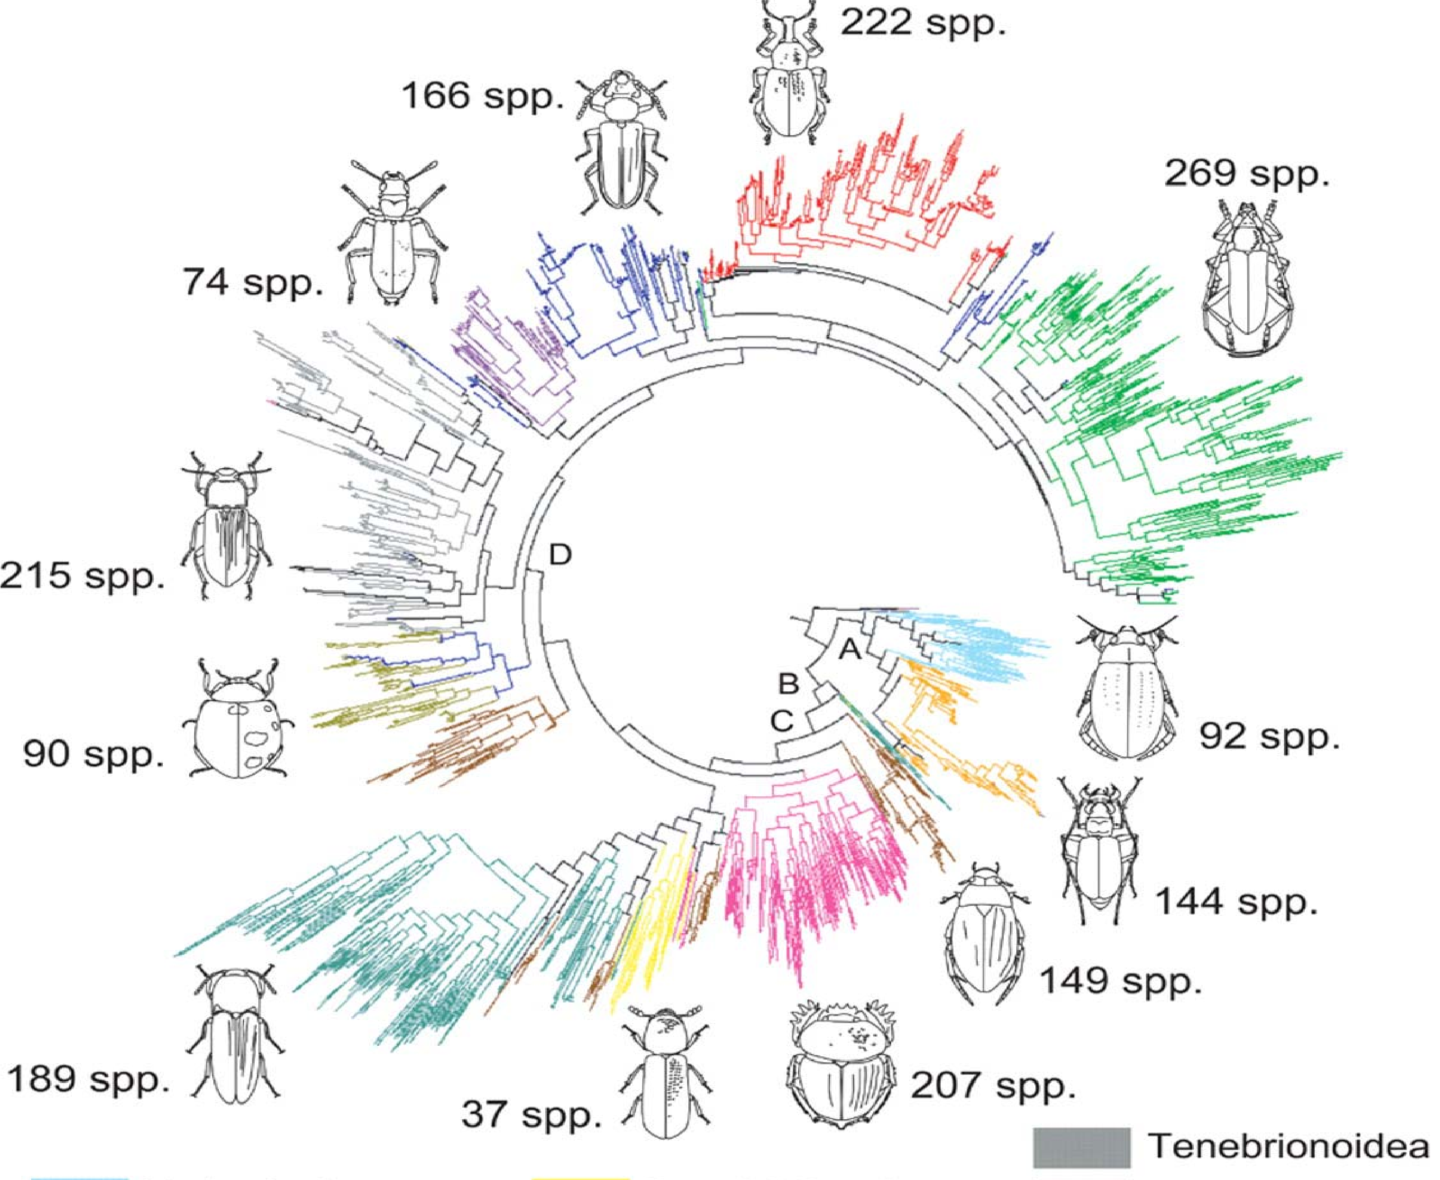

Slide 5
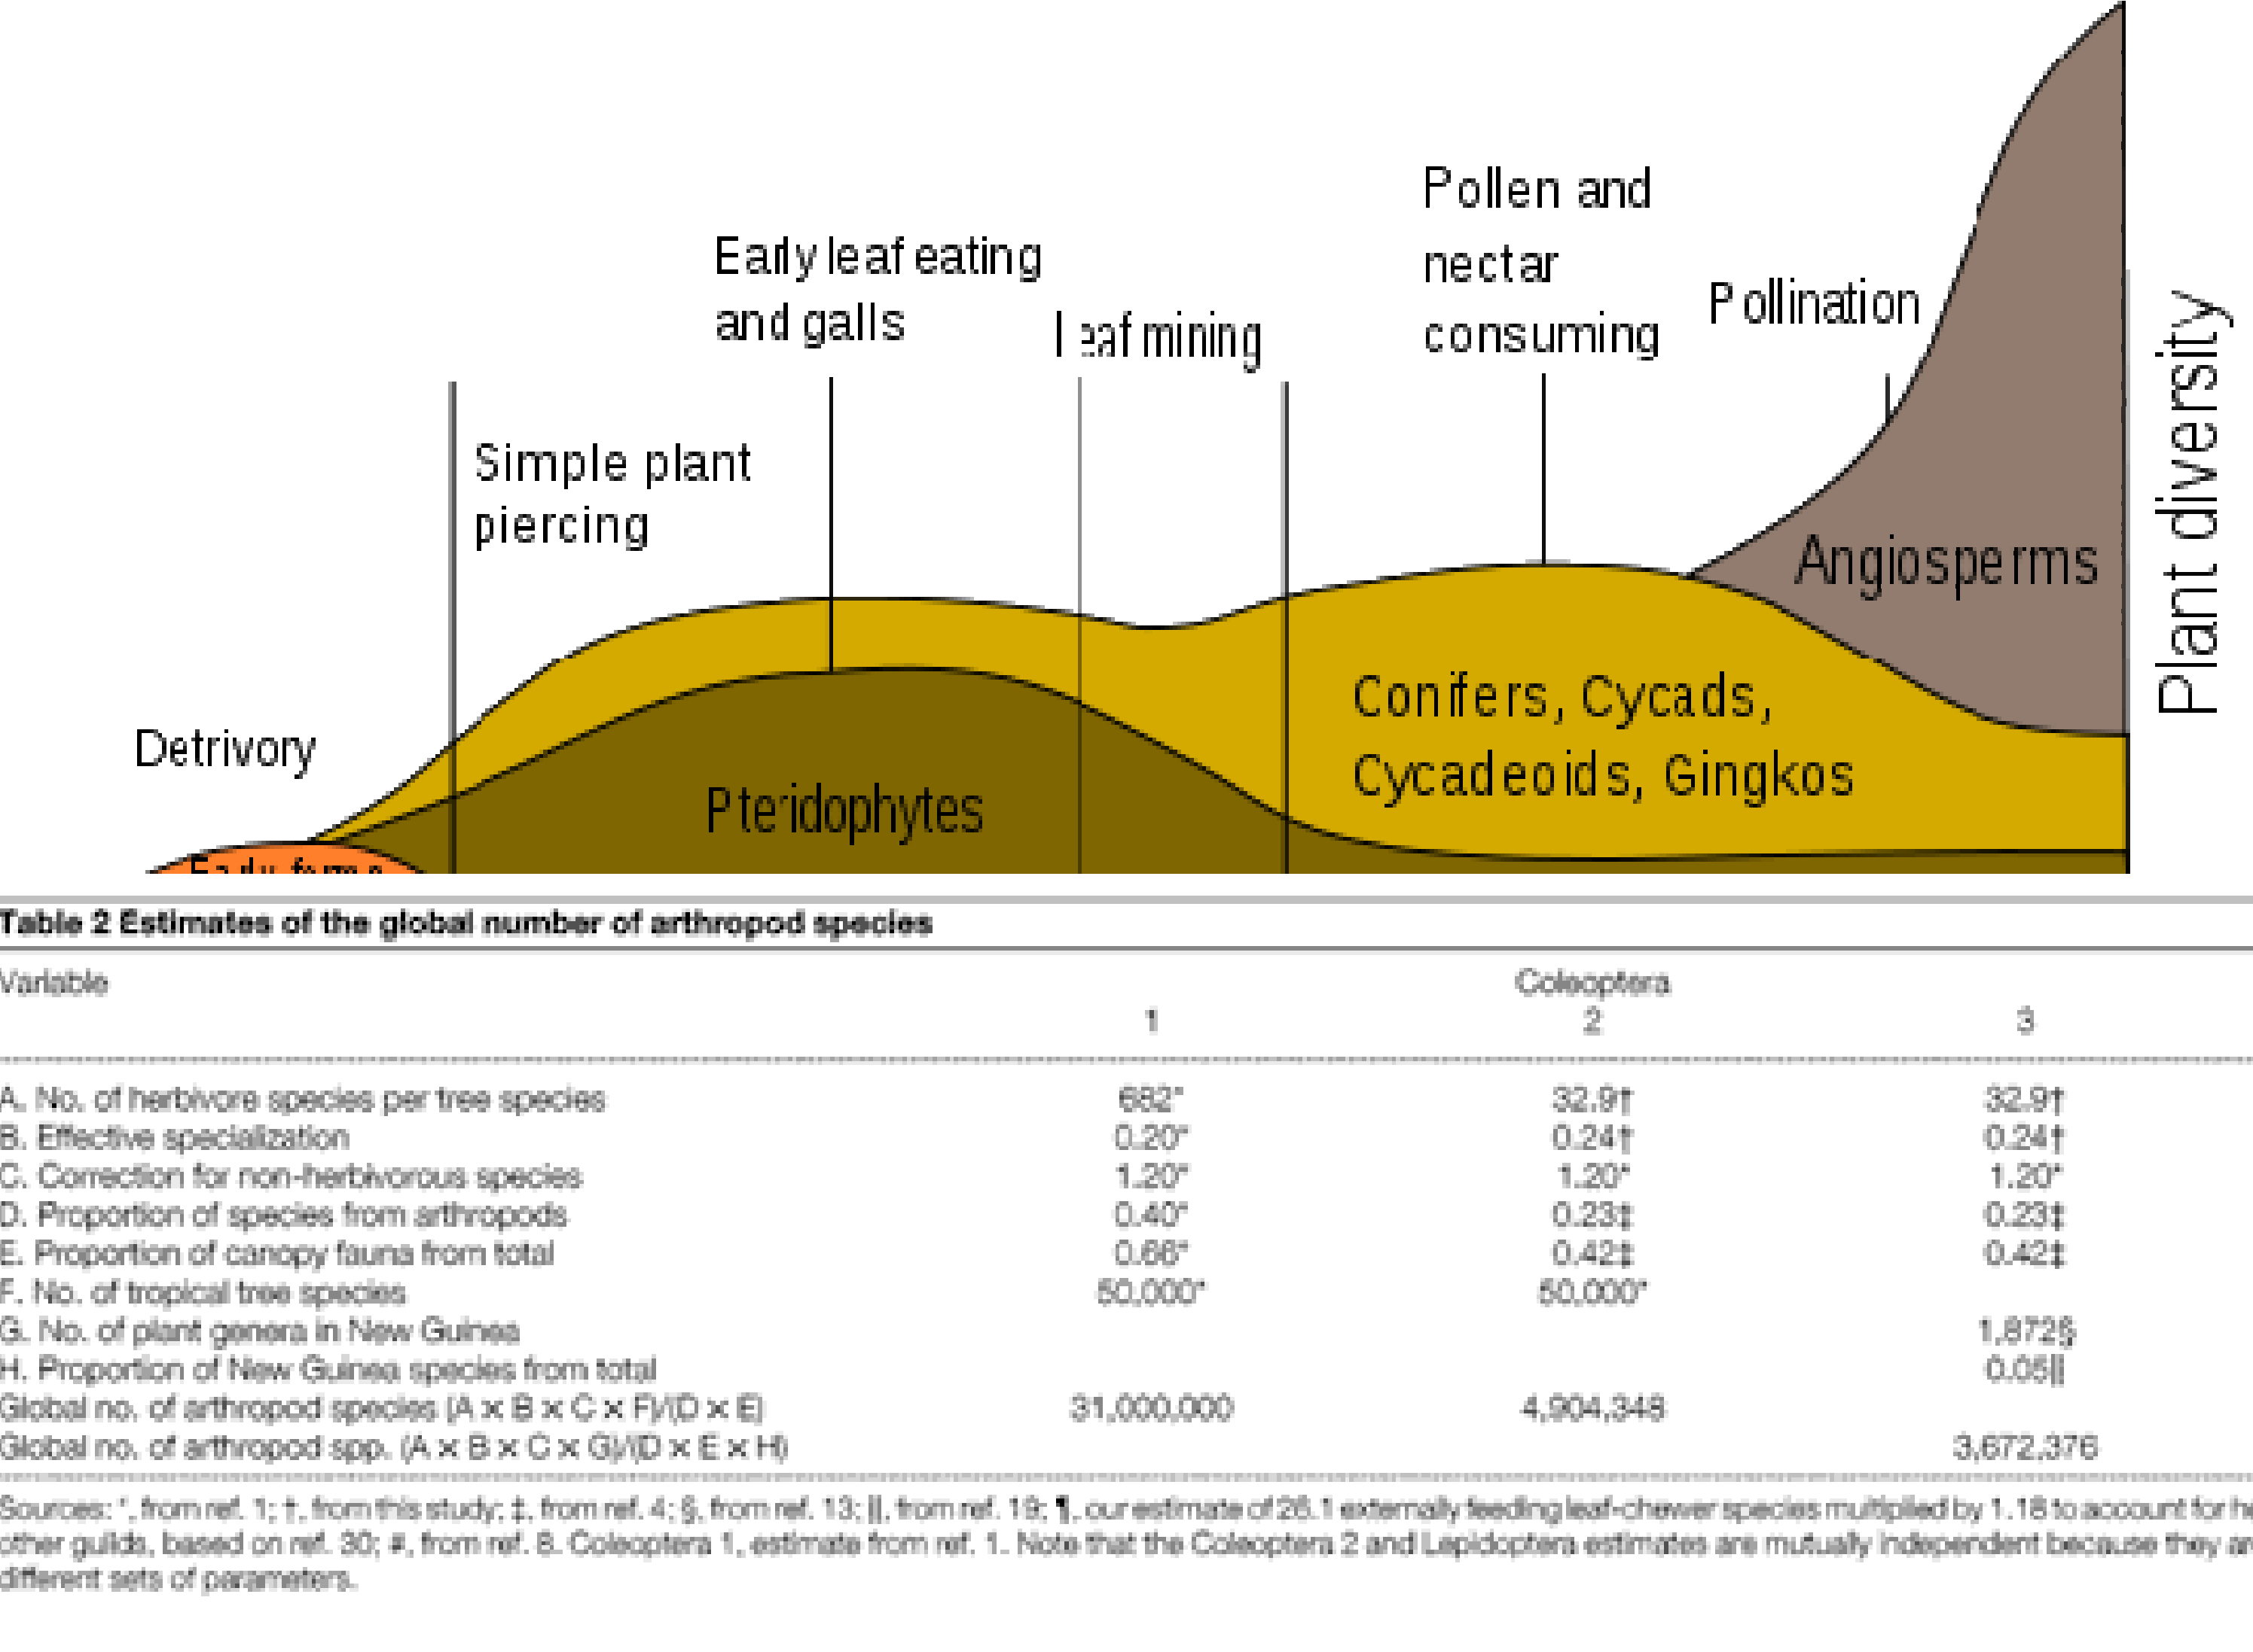

Slide 6
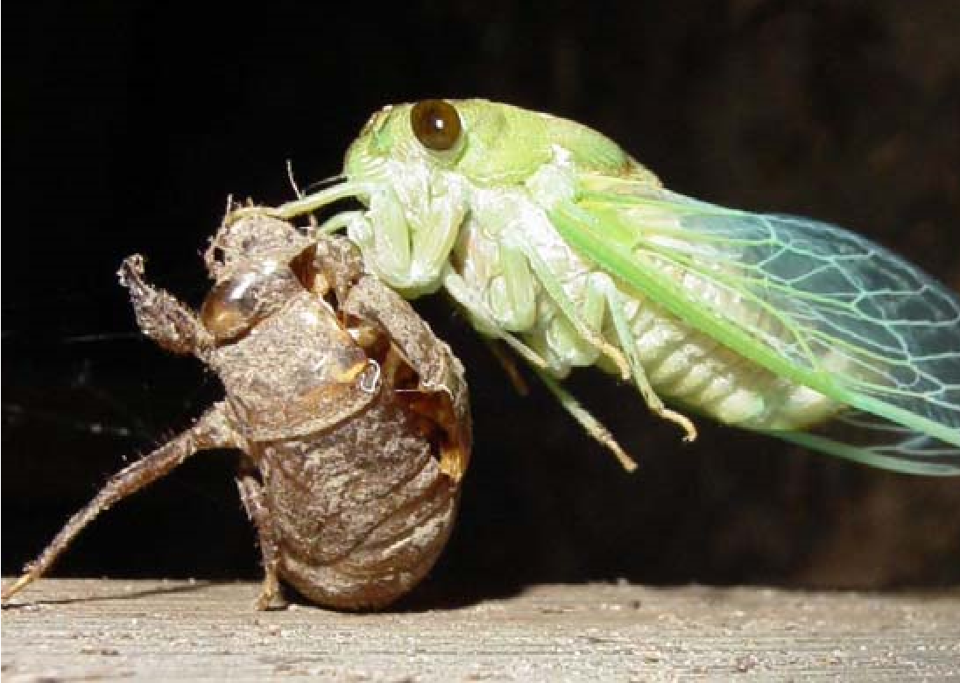
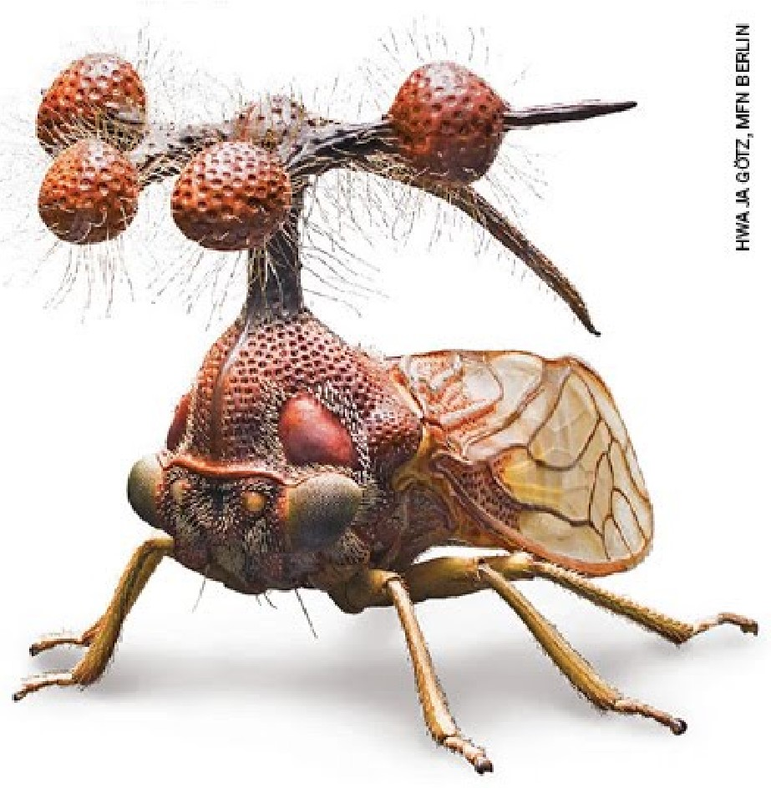
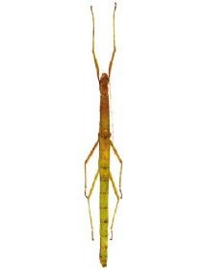
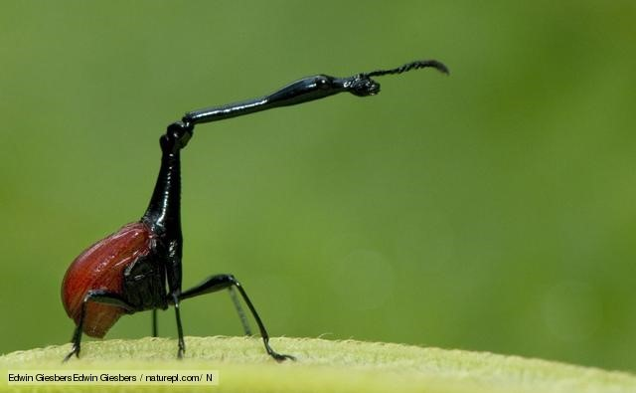
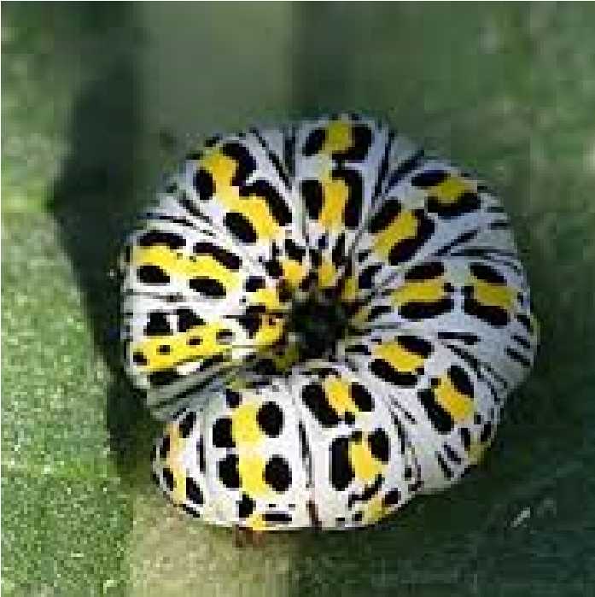
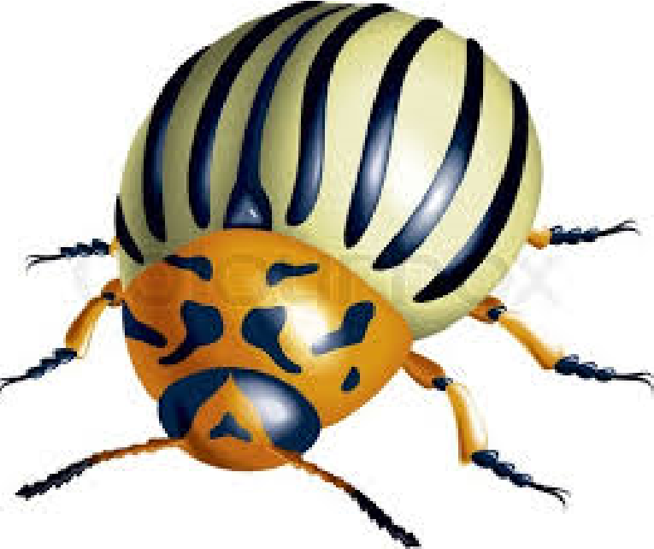
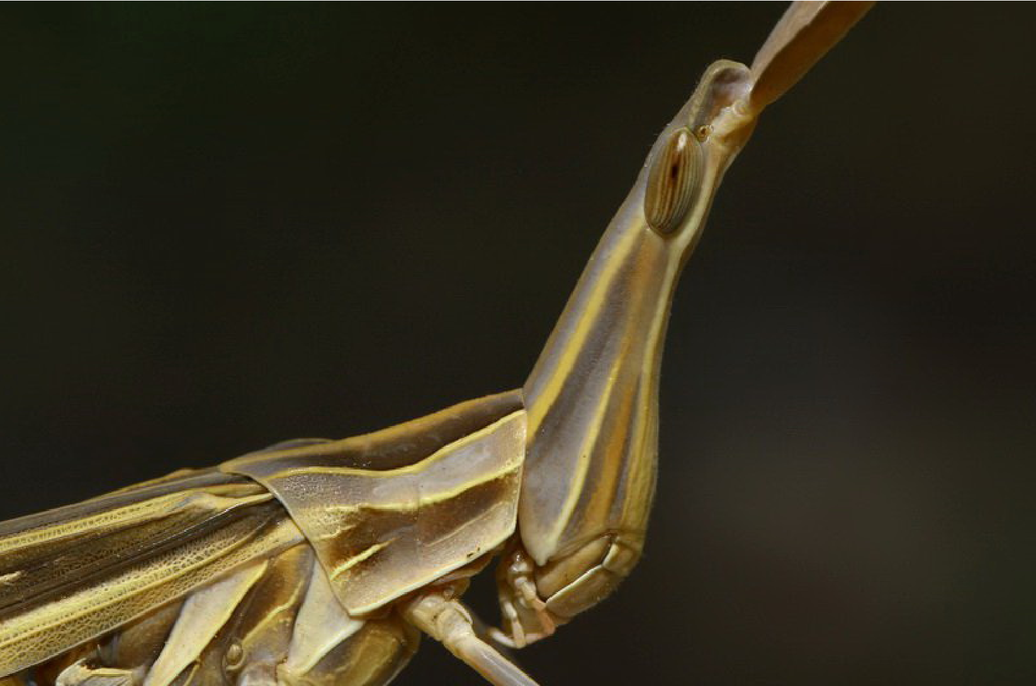
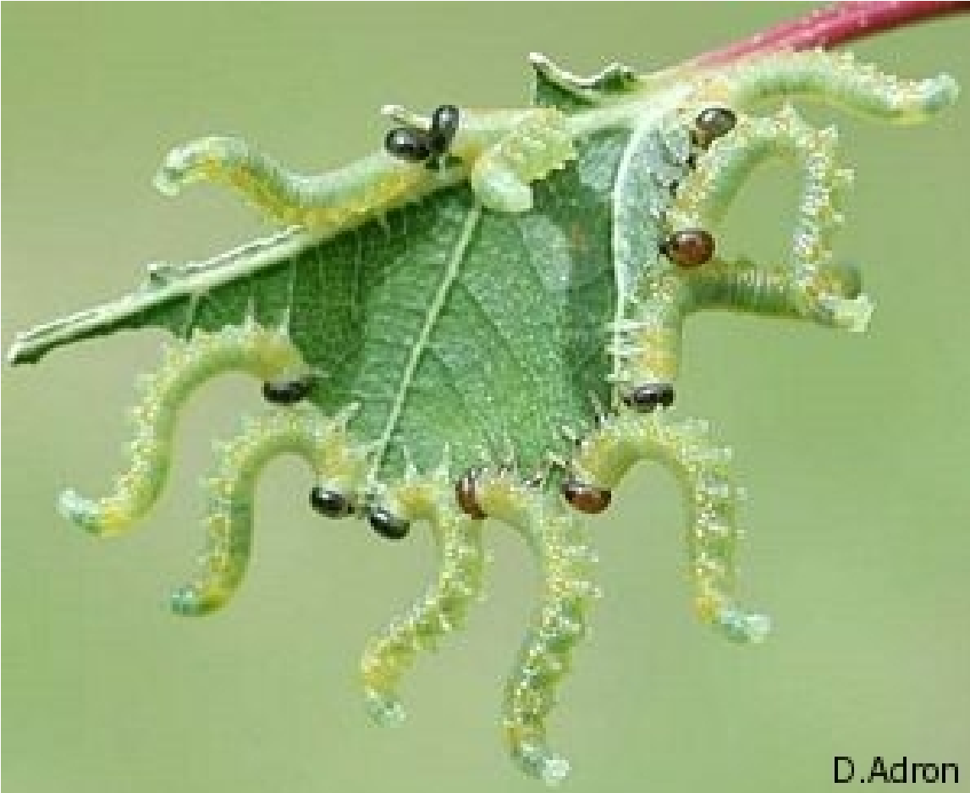
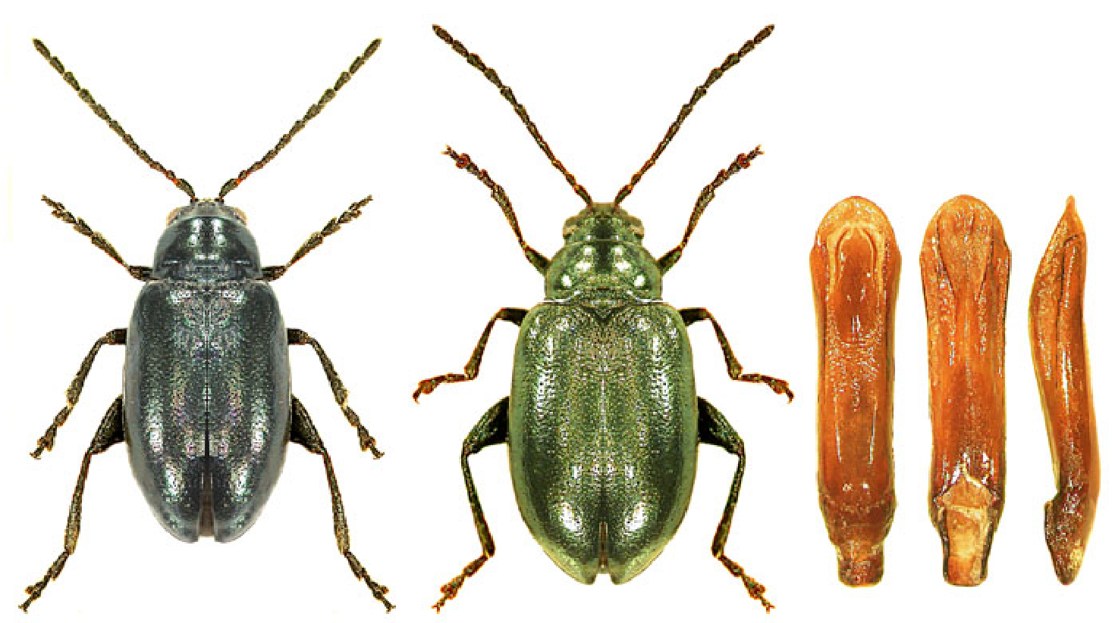
Phytophages

Slide 7
Phytophages
Potential food everywhere

Slide 8
Phytophages
Potential food everywhere
But most:
1
/ low in nutrients
2
/ poisonous
3
/ tough to chew
4
/ indigestible
5/ rare in time or 6/ space

Slide 9
Phytophages
Potential food everywhere...
But most:
1
/ low in nutrients
2
/ poisonous
3
/ tough to chew
4
/ indigestible
5/ rare in time or 6/ space
…, but not much to eat

Slide 10
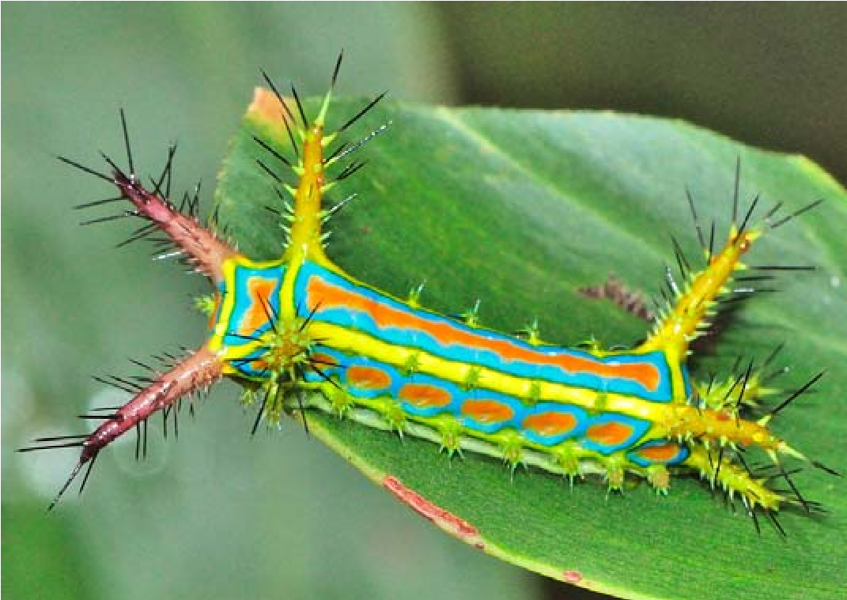
Phytophages
Potential food everywhere
World is full of inedible and dangerous things
- parazites
- parazitoids
- Predátors
- Diseases, moulds…
= herbivores need to hurry

Slide 11
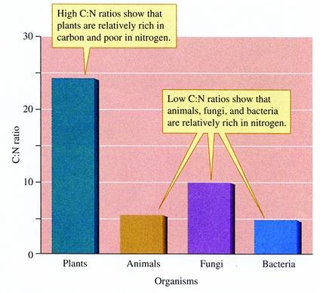
Phytophages
Potential food everywhere
Plants – mainly carbohydrates
Animals – mainly
Herbivores – limited by food nutrien content, mainly NITROGEN

Slide 12
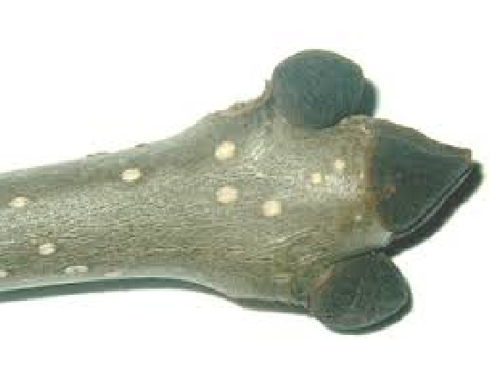
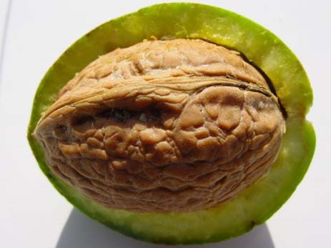
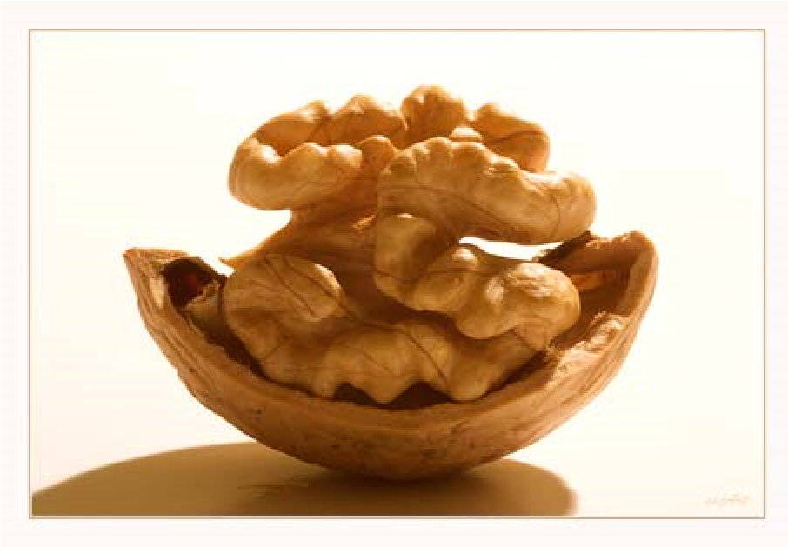
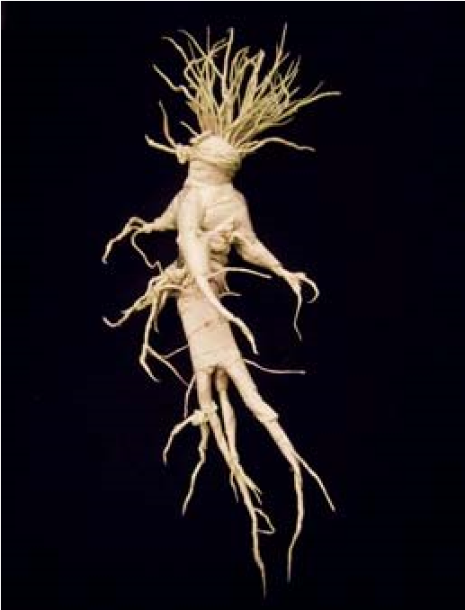
Phytophages- guilds
According to the plant part they exploit

Slide 13
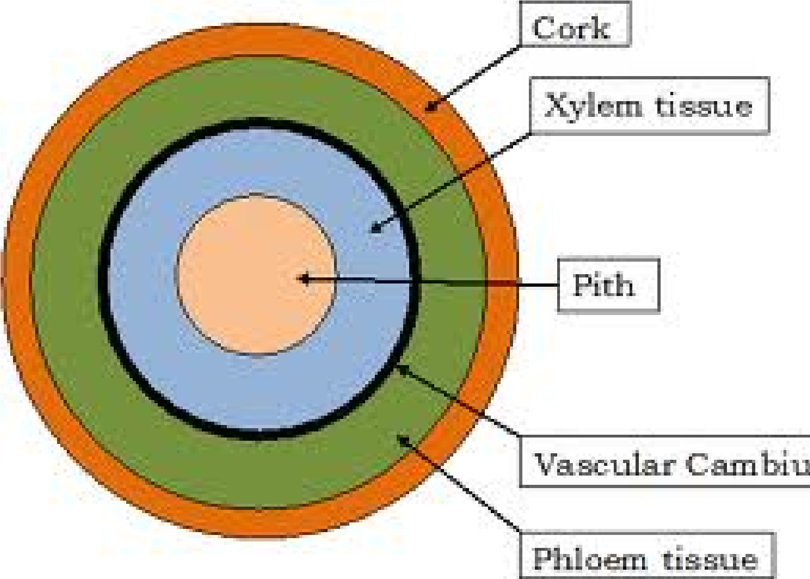
Phytophages- guilds
According to the plant part they exploit

Slide 14
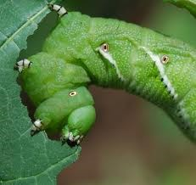
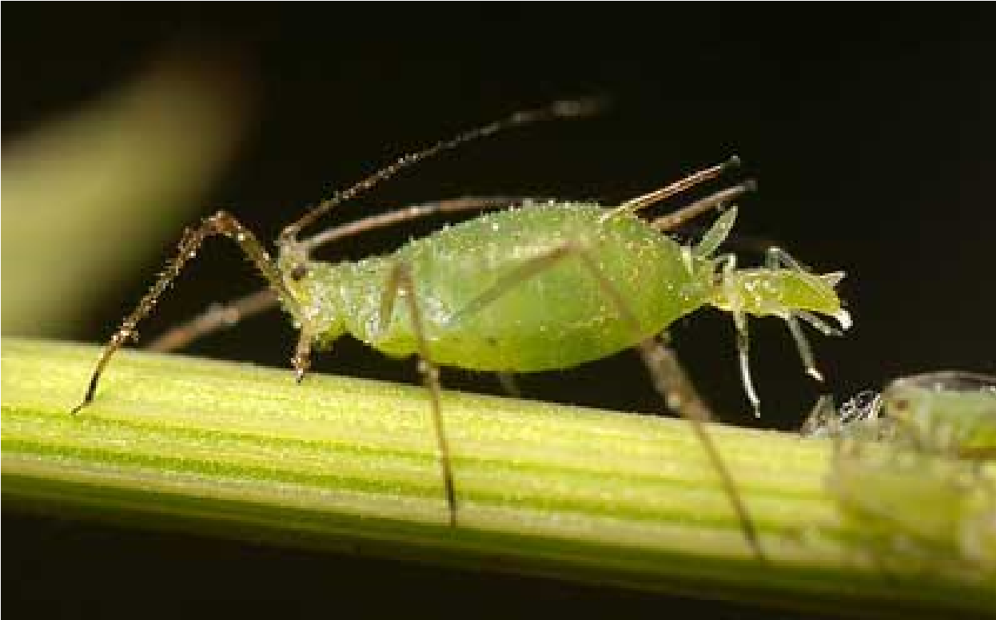
Phytophages- guilds
According to the way they feed
Chewing sucking

Slide 15
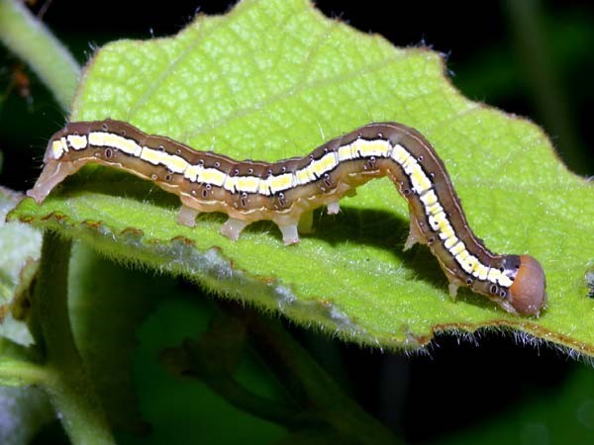
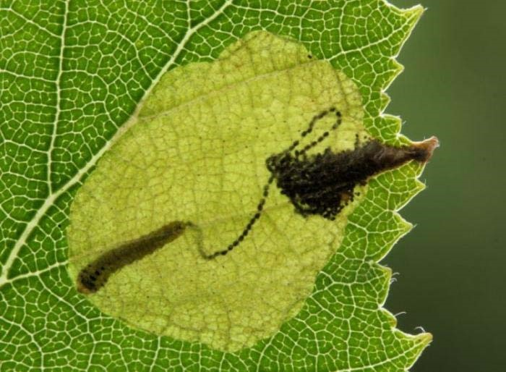
Phytophages- guilds
According to the way they feed
External Internal
Leaf mine

Slide 16
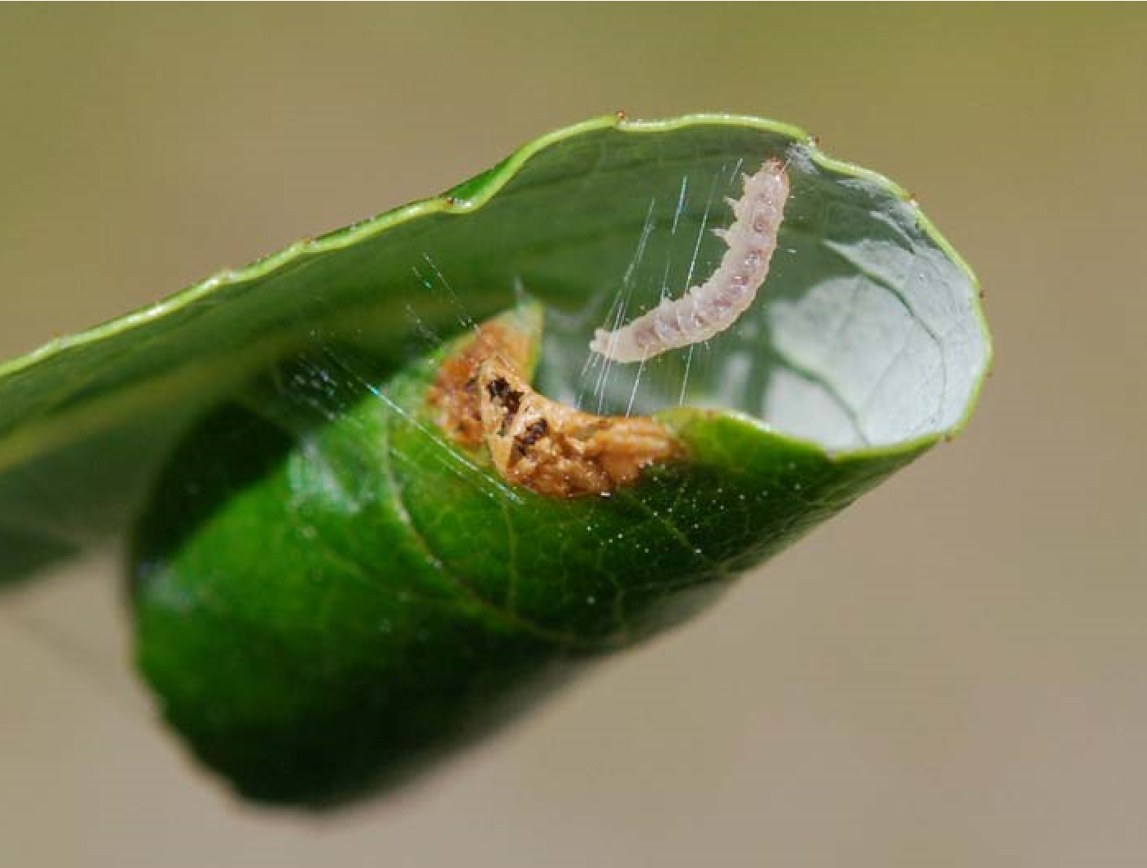
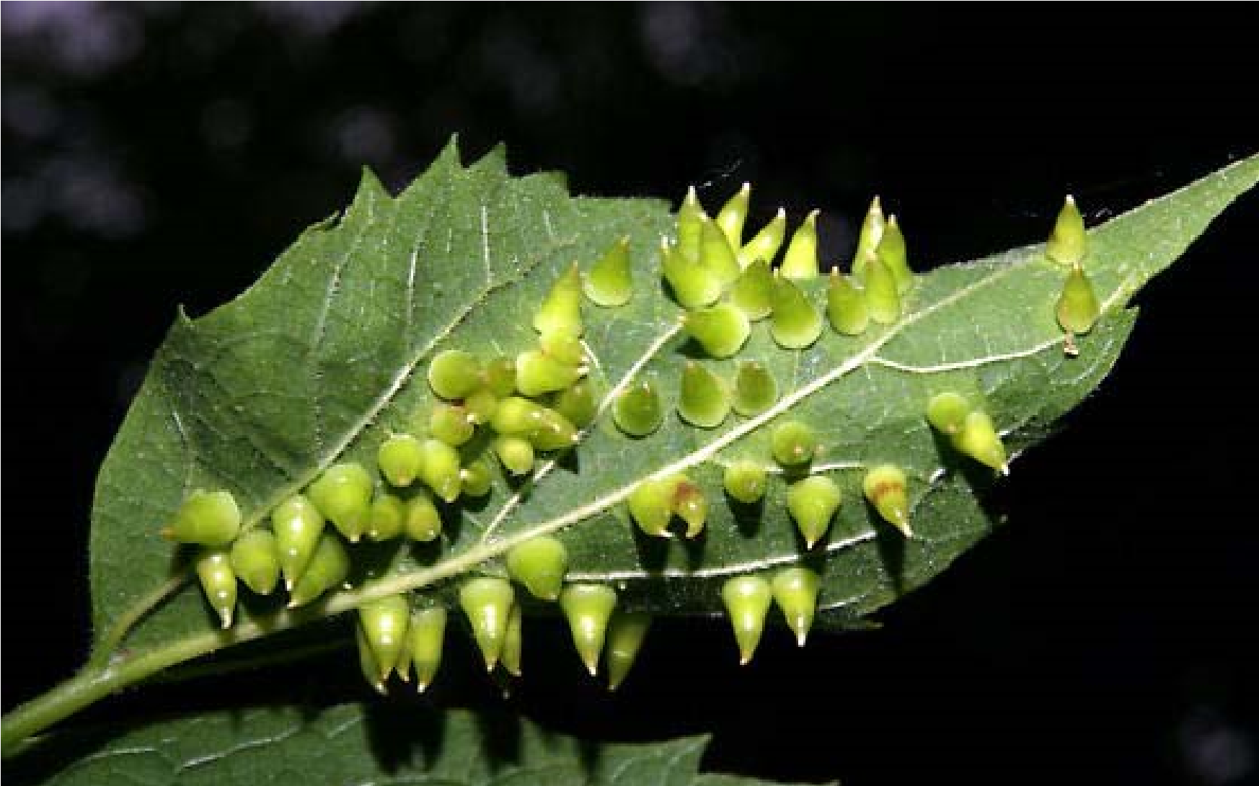
Phytophages- guilds
According to the way they feed
Galls
-
Rollers

Slide 17
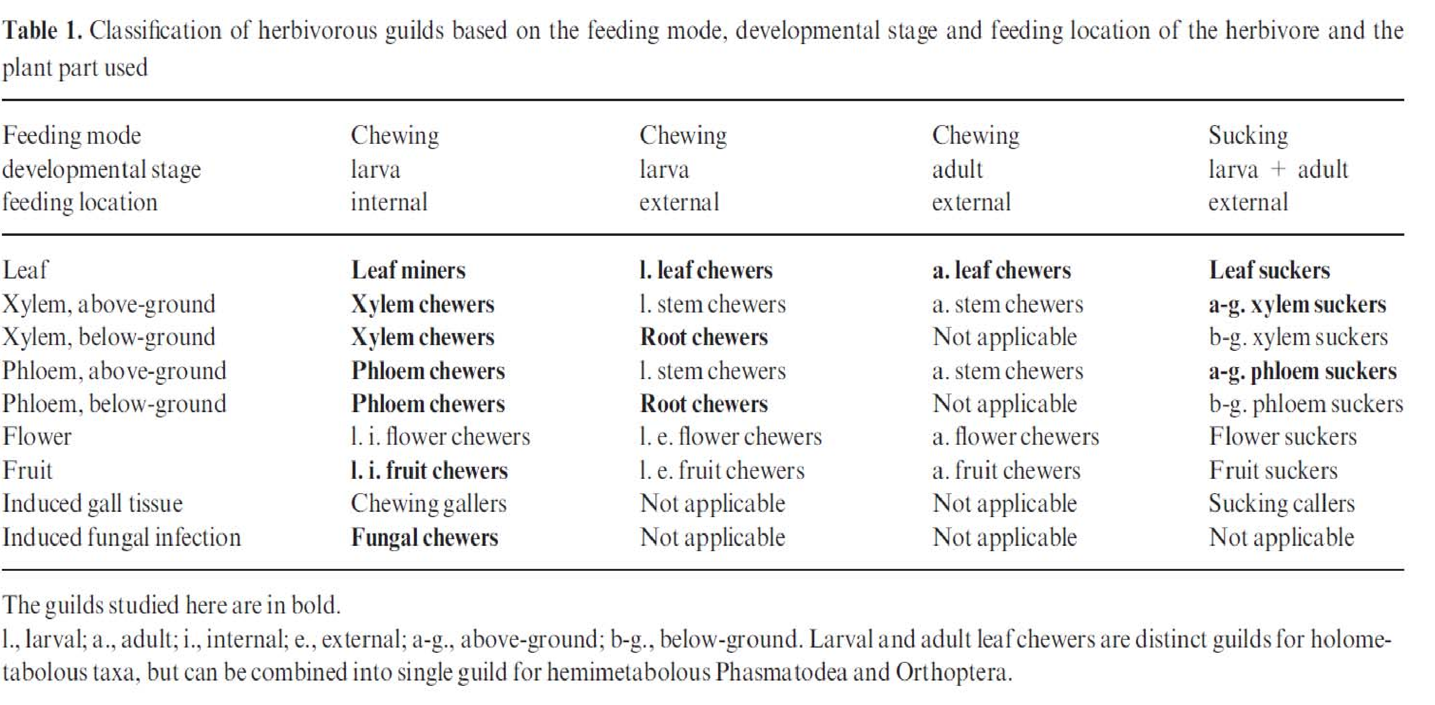
Phytophages- guilds
To make it a bit more complicated, feeding habits may differ between larva and imago

Slide 18
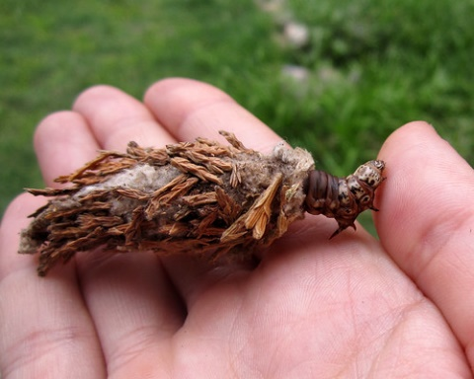
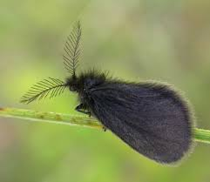
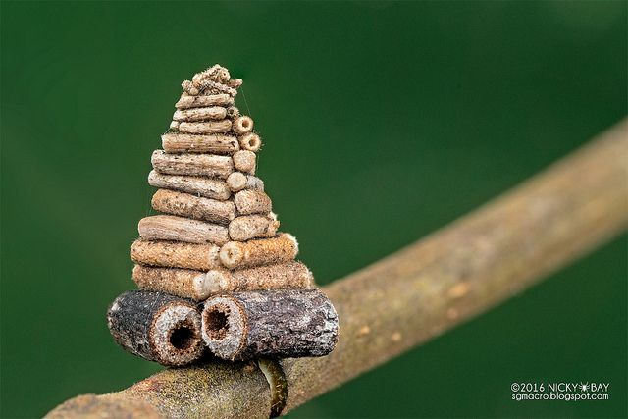
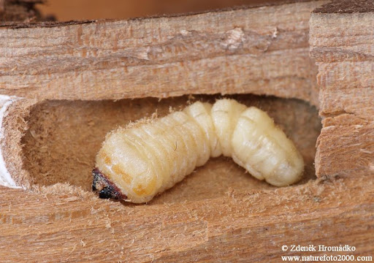
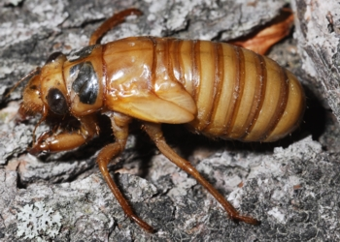
Phytophages- guilds
Clear and simple logic behind… Nitrogen is the main limiting factor
A herbivore exploiting nitrogen rich parts has rapid development (a caterpillar is „done“ in a few weeks = can survive feeding externally)
OR
A herbivore exploits nitrogen poor parts, development takes long, so it needs good protection.
Cerambycid larvae several years in the wood
Cicadas – sucking xylem in soil, up to 17 let
Bag worms (Psychidae) caterpillars with long development

Slide 19
Phytophages- guilds
Plants–
Rich in N – mainly rapidly growing parts
Young leaves, flowers, buds, unripes fruits, seeds
= high demand
= well protected
Poor in N – the rest
Mature leaves, stems, branches, roots
= low demand
= low investment in protection

Slide 20
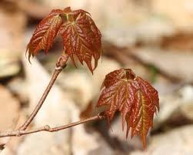
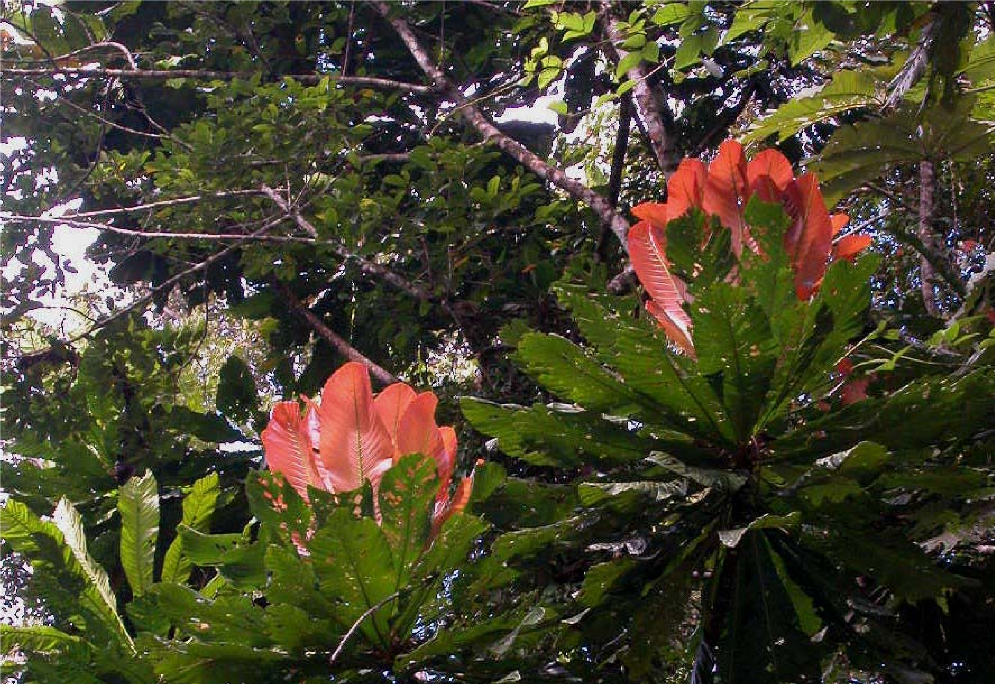
Young leaves
Crucial resource – predictable, common

Slide 21
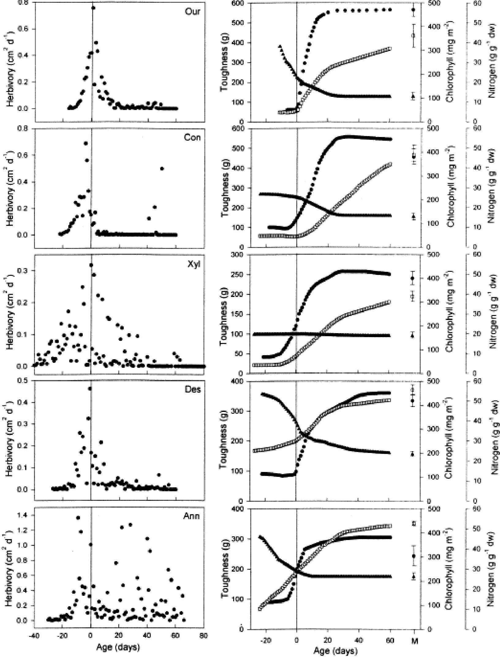
Herbivory decreases with leaf age (Kursar& Coley 2004)
So does nitrogen content
Leaf toughness increases
Young leaves often protected
alcaloids
colour
hairs....

Slide 22
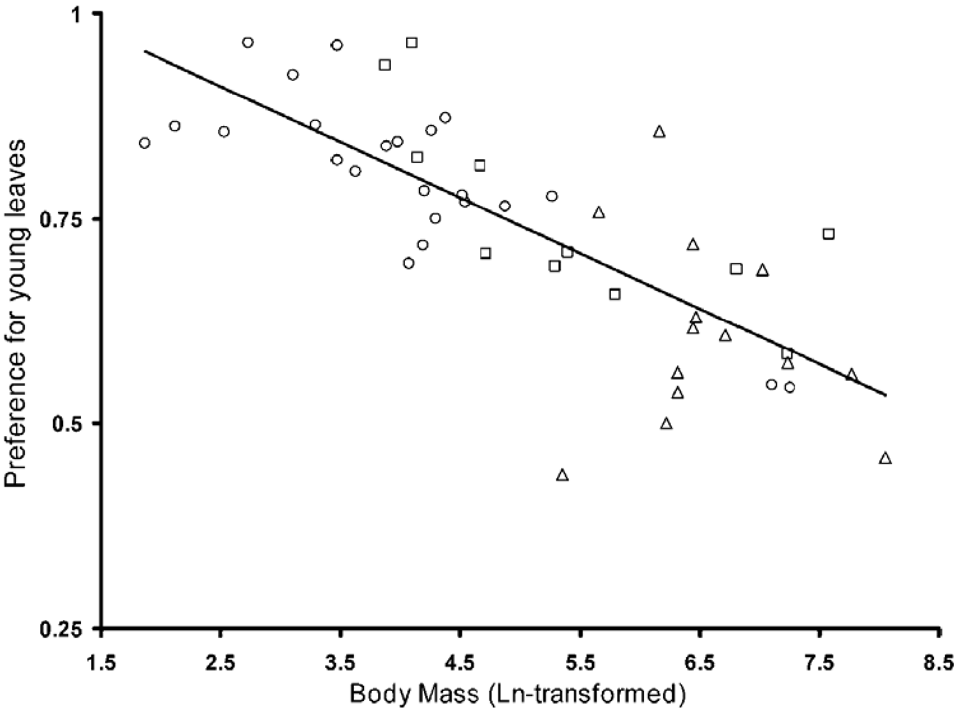
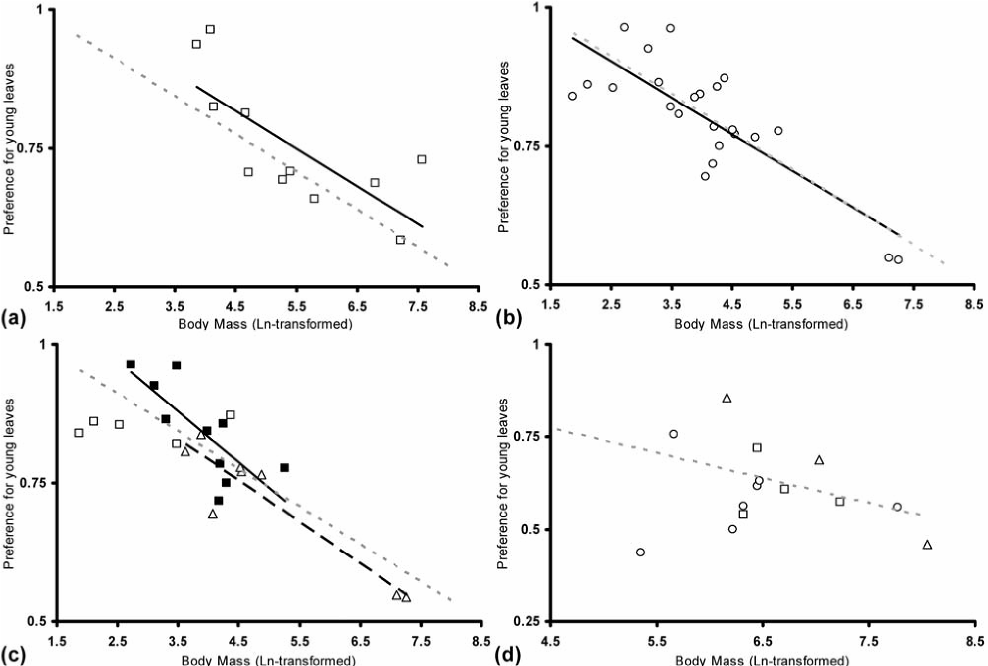
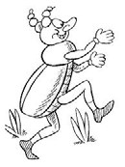
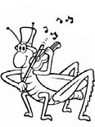
Preference for young leaves (= nutrient rich food) decreases with body size in insects

Slide 23
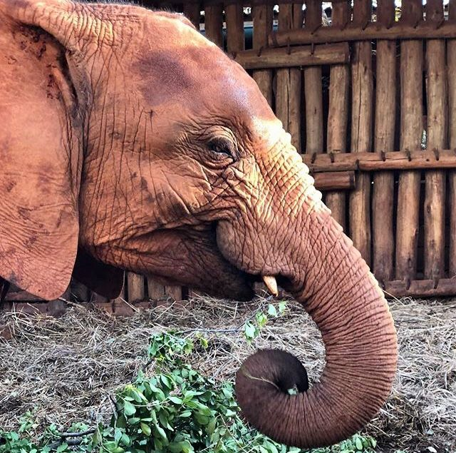
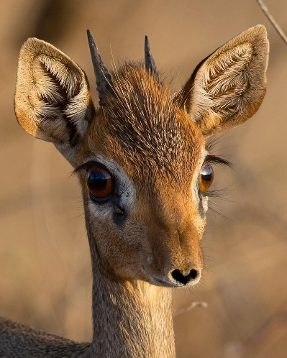
Preference for young leaves (= nutrient rich food) decreases with body size in insects
And vertebrates alike

Slide 24
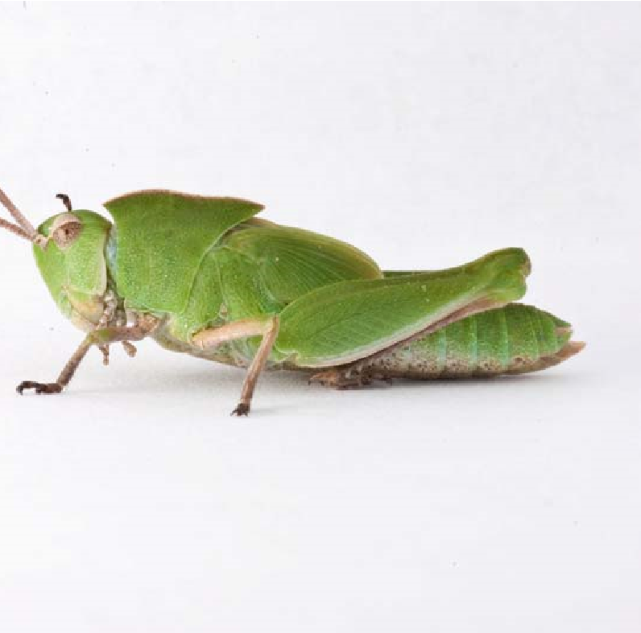
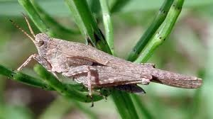
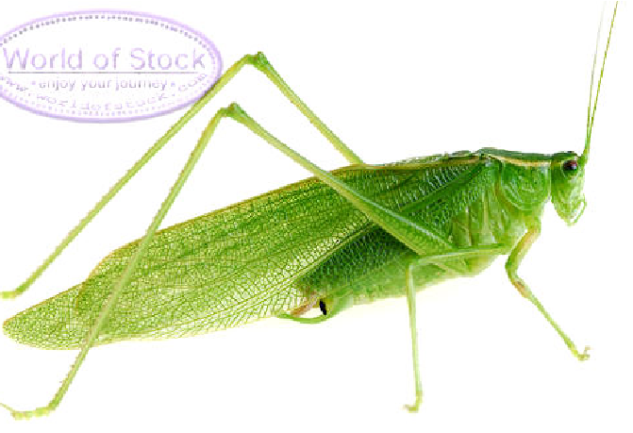
Preference for young leaves decreases with increasing body size
Small herbivores – lower metabolic rate, lower effectivity of digestion
Short „window of opportunity“, timing is important
„Leaf-flush“ is key to seasonality of folivores
Grasshoppers and deers alike
Pygmy grasshopers (Tetrigidae)
Feed on algae
very low
seasonality
Orthoptera
<= folivores
<=partly folivorous
Hatch in the spring

Slide 25
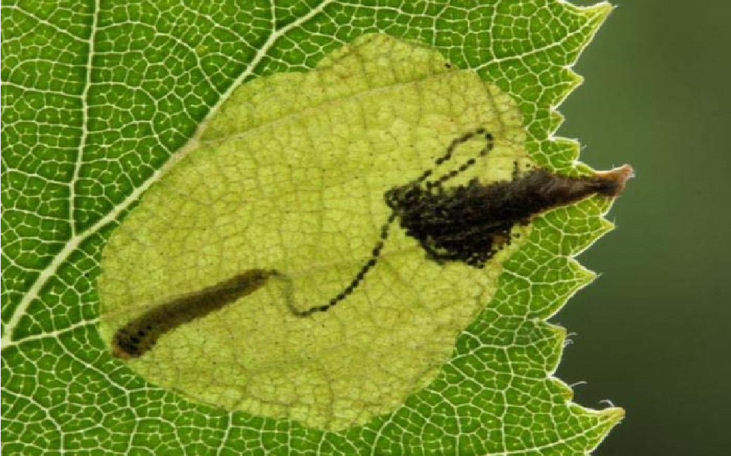
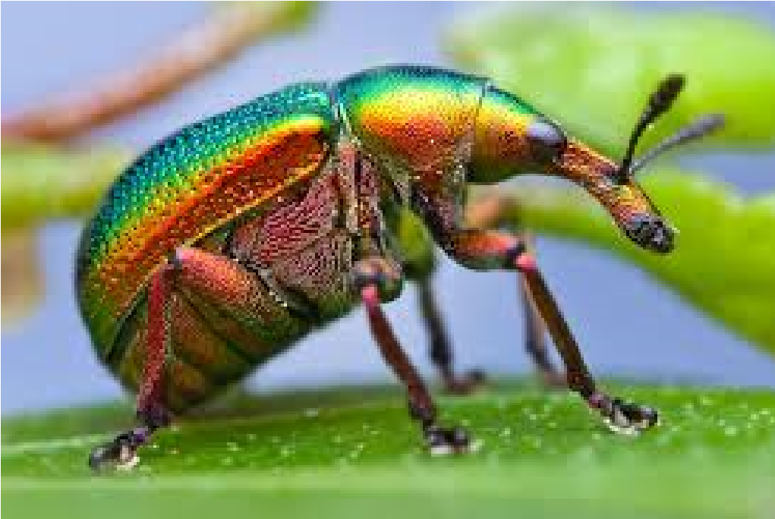
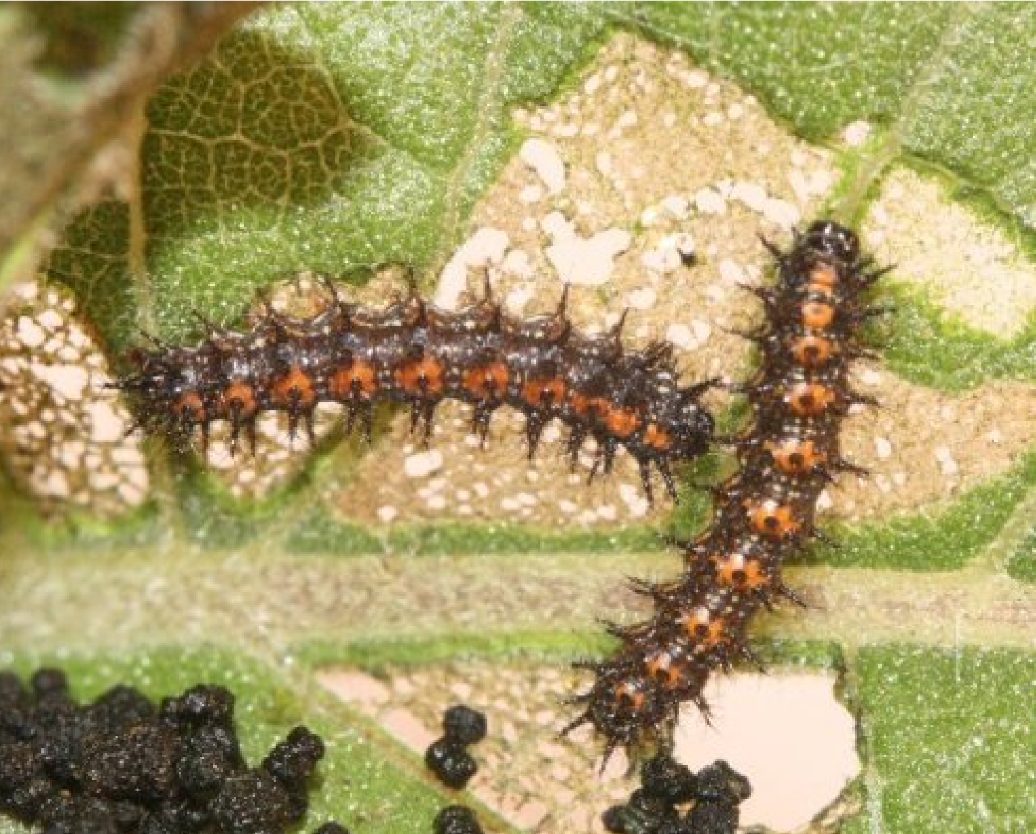
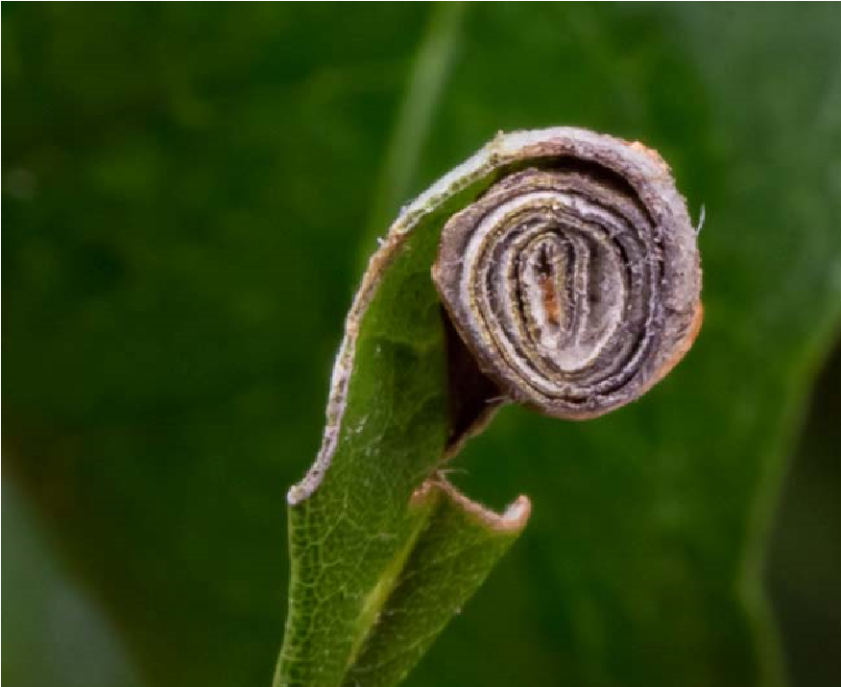
How to overcome this constraints?
Leaf mining – only softer tissue, not epidermis
Leaf skelotonizing– avoiding tougher veins
Leaf rolling – rolled leaf lacks light, becomes softer, more nutritious & protects larva, so it has more time (Attelabidae)=>

Slide 26
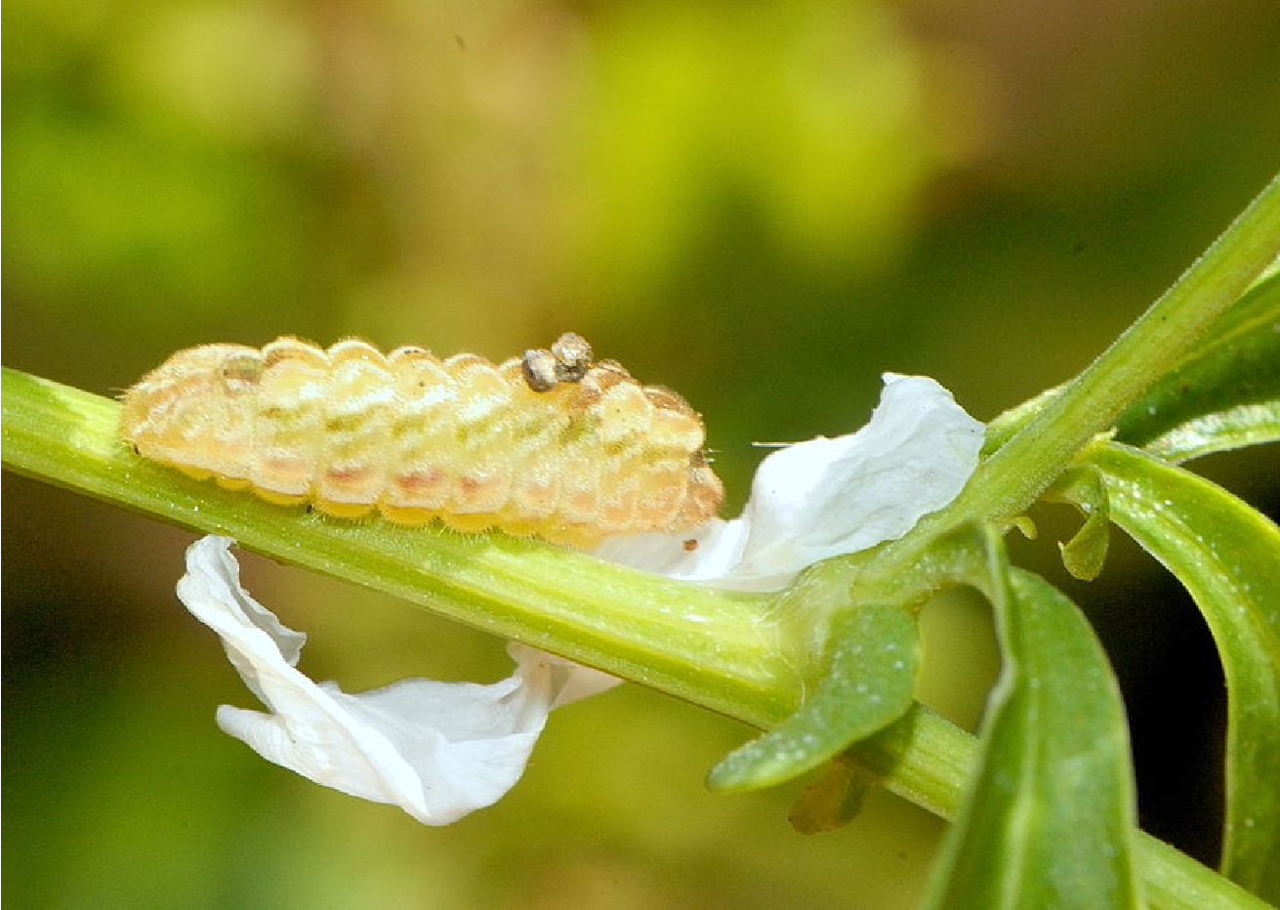
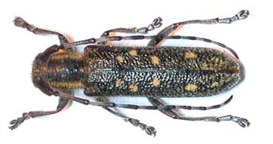
How to overcome this constraints?
Eat something else – in absence of young leafs, larva can „start“ on flowers or young fruits– e.g. Lycaenidae
Or to force the plant to form nutrient rich,softer tissues. Galls often to tough, sclerophylous leaves. Insect wound the plant and/or use phytohromones

Slide 27
How to overcome this constraints?
Team up with someone, who knows how to 1/ digest the food (e.g. Fungus)
2/ get nitrogen elsewhere
(nitrogen fixing bacteria in barkbeetles, termites…)

Slide 28
Main plant defence strategies
Theory of plant apparency (Feeny 1976)
Apparent plants - mainly quantitative defences – low water and nutrient content, high toughness, digestibility reducers (polyphenolics) expensive investment, effectivity increases with amount, impossible to move within plant
Not killing the herbivore, just preventing their developlment
Always effective (no resistance of herbivores)
Mainly trees, shrubs and grasses
Herbivores mainly generalists

Slide 29
Main plant defence strategies
Theory of plant apparency (Feeny 1976)
Unapparent plants - mainly qualitative defences – toxins that work in low concentrations, not big investment, possible to move within plant
Prevents feeding by generalists, BUT allows for resistence, herbivores – mainly resistant specialists
Mostly herbs, but also trees (e.g. Salix)
Apparent-unapparent plants – continuum, but working concept
Chrysomelinae leaf beetles feed mostly on unapparent, poisonous plants
Host plant apparency affects number of generations in butterflies

Slide 30
Typical unapparent plant
Milkweed (Asclepias),
herbivores:
monarch butterfly (Danaus plexippus)
Milkweed beetle (Tetraopes tetraophthalmus)
Milkweed leaf beetle (Labidomera clivicollis)
All poisonous. Specialist herbivores use plat toxin to their own defence from predatores
Always some herbivore becomes resistant. And the plant has to escape in space or time.

Slide 31
Host specificity
Higher among herbivorous guilds feeding on more nutritious, and hence better protected plant parts

Slide 32
Diversity of Herbivores
How many species feeds on a plant species?
Theory of Island biogeography
Isolation:
Phylogenetical
Chemical
Defense strategies
Spatial (plant distribution range – large / small)
Rarity (common resource more likely to be exploited)
– historical factors – plants that were common in the past have more herbivores

